Slide 1
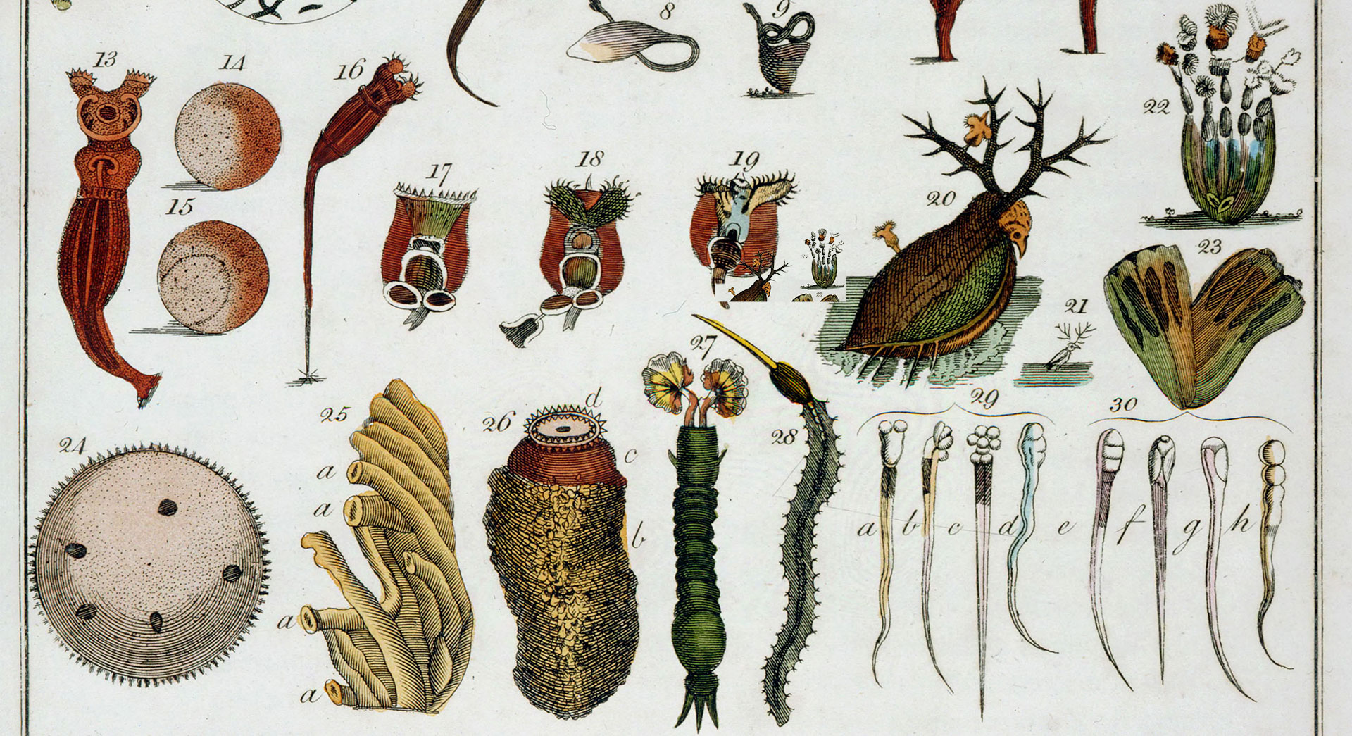
Life Is Cellular
Notes:
Read the lesson title aloud to students.

Slide 2
Learning Objectives
Explain the main points of the cell theory.
Explain how microscopes work.
Compare prokaryotic and eukaryotic cells.
Notes:
Click to reveal each of the learning objectives.
Tell students each organism is made up of small units called cells.
Explain that until the invention of the microscope, scientists didn’t know that all organisms are made up of cells.
Ask: How might our lives be different if microscopes were never invented?
Answer: Students will share different ideas. For example, our understanding of health and medicine would be significantly less than it is today.

Slide 3
The Discovery of the Cell
Anton van Leeuwenhoek was the first to observe living microorganisms.
Notes:
Tell students that the first microscopes were made in the 1500s by eyeglass makers in Europe.
Tell students that Robert Hooke looked at slices of cork in 1665. He saw something similar to what van Leuwenhoek drew in image H.
Click to highlight image H.
He called these cells. This term is used to this day to identify these structures.
Ask: Why might he have chosen the word “cell”? How else is this word used?
Answer: These look like rows of monastery rooms (called cells).
Click to remove the circle.
Introduce Anton van Leeuwenhoek, who was the first to see living microorganisms. Identify the image on the screen as a drawing he made of organisms he found in his mouth.
Tell students that by the mid 1800s, scientists had discovered that all living things are made of cells.
Historical details: In 1838, German botanist Matthias Schleiden concluded that all plants are made of cells. The next year, German biologist Theodor Schwann stated that all animals are made of cells. In 1855, German physician Rudolf Virchow concluded that new cells can be produced only from the division of existing cells, confirming a suggestion made by German Lorenz Oken 50 years earlier.

Slide 4
The Cell Theory
All living things are made up of cells.
Cells are the basic units of structure and function in living things.
New cells are produced from existing cells.
Notes:
Explain that the studies of cells led to the cell theory.
Click to reveal each component of the cell theory.
Ask: What are some ways the discovery of new ideas can take place?
Sample answer: Some discoveries come about as new technologies are developed.
Ask: What technology helped in the discovery of cells?
Answer: the microscope
Ask: What are the three parts of the cell theory?
Answer: All living things are made up of cells; cells are the basic units of structure and function in living things; new
cells are produced from existing cells.
Ask: What does it mean that cells are the basic units of structure and function?
Answer: All processes and actions a living thing does come down to cellular activity.

Slide 5
Exploring the Cell
Most microscopes use lenses to magnify the image of an object by focusing light or electrons.
Notes:
Ask: Why has the advancement of microscopes changed the world of biology and medicine so immensely?
Answer: All actions a living thing does come down cellular activity. Without microscopes, people would not have any idea how living things actually function.

Slide 6
Electron Microscopes
Two types of electron microscopes:
transmission
scanning
Notes:
Ask students the main difference between light and electron microscopes (EM).
Answer: The power of magnification differs greatly. Electron microscopes are much more powerful and have given scientists an incredible tool.
Click to reveal the text about transmission versus scanning electron microscopes.
Tell students the difference between a transmission and scanning electron microscope:
Transmission: Samples must be cut into thin slices to be viewed, which means the samples are viewed two-dimensionally.
Scanning: Samples can be viewed three-dimensionally.
Tell students that for both types of EM microscopes, samples cannot be living. In light microscopes, samples can be living.

Slide 7
Micrographs
A micrograph is a photo of an object seen through a microscope.
Light Microscope
Transmission Electron Microscope
Scanning Electron Microscope
Notes:
Explain that these three images are all of the same thing (yeast) as seen under three different microscopes.
Ask students to identify which microscope made each image.
Volunteers can either write the answers on the board or state the answers verbally.
Click to reveal each answer.

Slide 8
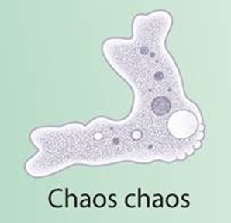
Cell Size
Certain units of measurement are used for
tiny objects, such as cells.
Notes:
The abbreviations for units of measurement appear in the illustration.
Tell students: nm is the abbreviation for nanometer, and μm is the abbreviation for micrometer.
Tell students: μ is the Greek letter mu.
Call students’ attention to the conversion table. Go over this conversion scale, explaining all the conversions; for example, that one nanometer is equal to one one-billionth of a meter. It may help to reverse the relationship; that is, to explain that one meter contains one billion nanometers and one million micrometers.
Point out the limitations of the human eye.
Click to highlight the arrow.
Point out the limitations of the light microscope
Click to highlight the arrow.
Click to remove the arrow.
Invite students to the board to identify the size of the following items.
Click to reveal each item along the scale after students have guessed the sizes:
Chicken egg (5 cm)
Typical eukaryotic cell, animal or plant cell (10–100 µm)
Typical prokaryotic cell, bacterial cell (1–5 µm)
Mitochondrion, a component of a eukaryotic cell (1–5 µm)
Chaos chaos, an amoeba (1mm)
Cold Virus (25 nm)
DNA (2 nm)
Point out that the items in the illustration are not drawn to scale; for example, in the illustration, the bacterium, mitochondrion, and eukaryotic cell are all roughly the same size, but in actuality, these items have sizes that are very different from one another.
To help students understand the actual relationship in size between some of the items in the illustration, you might draw a typical prokaryotic cell and a typical eukaryotic cell to scale on a large sheet of paper. Use circles to represent the cells. To represent the prokaryotic cell, draw a circle with a diameter of 0.5 cm. For the eukaryotic cell, draw a circle with a diameter of 25 cm.

Slide 9
Prokaryotes and Eukaryotes
Nucleus
Nucleus
Cell Membrane
Cell Membrane
Cell Membrane
Notes:
Point out to students that the last slide separated two types of cells: prokaryotic cells, which are smaller, and eukaryotic cells, which are larger.
Place students in groups and have them create a Venn diagram showing the similarities and differences between prokaryotic and eukaryotic cells.
Discuss these as a class.
Click three times to reveal the labels for each of these structures; each click will reveal one structure individually:
Cell Membrane
Nucleus
Point out that although prokaryotic cells are simpler, they are still able to carry out all of the functions of life.
Students may also notice that there are differences between plant and animal cells. Point out that both prokaryotic and eukaryotic cells display great variety.

Slide 10
Two Major Types of Cells: Prokaryotes & Eukaryotes
Prokaryotes:
Smallest, most simple cell;
early prokaryotes lived at least 3.5 billion years ago
No nucleus & no membrane-bound organelles
Example = Bacteria and Archaea
DNA – single, circular molecule located in the center of the cell

Slide 11
Two Major Types of Cells: Prokaryotes vs. Eukaryotes
Eukaryotes
Larger, more complex cells
Early eukaryotes evolved 2.5 billion years ago
Cells that have a nucleus & membrane-bound organelles
Organelles – internal structures that carry out specific functions
Examples: Animal Cells (your cells); Plant Cells; Fungi Cells; Protist Cells
DNA – found in nucleus

Slide 12
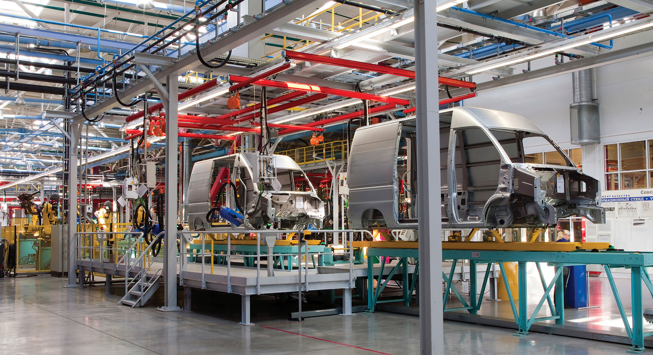
Cell Structure
Notes:
Read the lesson title aloud to students.

Slide 13
Learning Objectives
Explain the role of the cell nucleus.
Identify the cellular structures that make and transport proteins and other macromolecules.
Distinguish the functions of vacuoles, lysosomes, and the cytoplasm.
Compare the roles of chloroplasts and mitochondria.
Describe the role of the cell membrane.
Notes:
Click to show each of the learning objectives.
To assess prior knowledge, pair students and have them work together to draw a model of a cell. Encourage students to be as detailed as possible.
Ask: What are some of the structures you included in your cell model?
Write student answers on the board and ask them to describe each structure’s function if possible.
Ask: Are all cells the same? If not, how are they different?
Accept all reasonable answers.

Slide 14
Exploring Cell Organelles
Notes:
Tell students: These are representations of plant and animal cells and will be used throughout the lesson.
As each cellular component is discussed, students will see an image highlighting the component

Slide 15
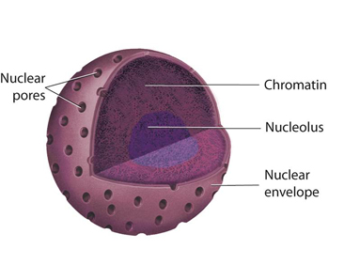
Nucleus
The nucleus controls most cell processes and contains DNA.
Note: Prokaryotic cells DO NOT have a nucleus
Animal Cell
Plant Cell
Notes:
The nucleus contains nearly all the cell’s DNA and, with it, the coded instructions for making proteins and other important molecules.
By contrast, prokaryotic cells lack a nucleus. Their DNA, containing the same kinds of instructions, is found in the cytoplasm.
Click to highlight each component of the nucleus.
Ask students to describe the structure of each component and hypothesize about its function.
Describe the function of each:
Nuclear envelope: a double-layered membrane barrier that protects the DNA
Nuclear pores: tiny holes in the nuclear envelope that allow certain components to enter and leave the nucleus
Chromatin: uncoiled DNA + proteins (the form DNA is in when it is not condensed into a chromosome)
Nucleolus: a specific area in the nucleus where ribosome assembly initiates

Slide 16
Nucleus, continued
Nuclear envelope: a double-layered membrane barrier that protects the DNA
Nuclear pores: tiny holes in the nuclear envelope that allow certain components to enter and leave the nucleus
Chromatin: uncoiled DNA + proteins (the form DNA is in when it is not condensed into a chromosome)
Nucleolus: a specific area in the nucleus where ribosome assembly initiates

Slide 17
Organelles That Build Proteins
Rough endoplasmic reticulum
Nucleus
Ribosome
Cell membrane
Cytoplasm
Protein
Smooth endoplasmic reticulum
Vesicle
Golgi apparatus
Notes:
Orient students by pointing out that this is the complete process shown in the last two slides. Ask the following questions to assess comprehension.
Ask: Where are proteins assembled?
Answer: ribosomes
Ask: What can you infer about a cell that is packed with more than the typical number of ribosomes?
Answer: When a cell has more than the typical number of ribosomes, you might infer that it produces more proteins than other cells.
Ask: Where is the synthesis of membrane proteins completed?
Answer: in the ER
Ask: How are proteins transported to the Golgi apparatus?
Answer: in vesicles
Ask: What happens to proteins leaving the Golgi apparatus?
Answer: They are sent out of the cell or back into the cytoplasm to be used.
Divide students into groups and have them create flowcharts summarizing the role of each of the following cellular structures in protein synthesis: nucleus, nuclear envelope, ribosomes, endoplasmic reticulum, Golgi apparatus, vesicles, vacuole, and cell membrane. Remind students that proteins can follow multiple processing paths depending on their destination, so the flowcharts may branch at some points.

Slide 18
Organelles That Build Proteins
1. Proteins are assembled on ribosomes.
2. Some proteins complete their assembly on the rough endoplasmic reticulum.
3. Proteins are carried to the Golgi apparatus in vesicles.
Notes:
Tell students that proteins carry out so many of the essential functions of living things, including the synthesis of other macromolecules such as lipids and carbohydrates, that a big part of the cell is devoted to their production and distribution.
This is a large picture, and will be seen over two slides (there will also be a third slide showing the entire picture).
Help students interpret this picture by asking the following questions.
Encourage students to describe what they see, then fill in the details for them.
Ask: What happens first?
Students will likely notice that a protein is coming off the ribosome.
If students are having a difficult time, help them follow the arrows backwards.
Click to reveal the answer.
Explain that ribosomes are small particles of RNA and protein found throughout the cytoplasm in all cells.
Ribosomes assemble proteins by following coded instructions that come from DNA.
Ask: What happens next?
Students will likely notice that the protein gets fed into the rough ER.
Click to reveal the answer.
Explain that proteins targeted for export to the cell membrane or to specialized locations within the cell complete
their assembly on ribosomes bound to the rough ER. Introduce the difference between the smooth and rough ER.
Ask: What happens next?
Students should notice that the protein ends up in a vesicle.
Click to reveal the answer.
Explain that newly assembled proteins are carried from the rough endoplasmic reticulum to the Golgi apparatus in vesicles.

Slide 19
Organelles That Build Proteins
5. Vesicles are shipped to their final destination.
4. The Golgi apparatus sorts and packages proteins.
Notes:
Orient students by pointing out that the vesicle is the same one from the previous image.
Ask: What does the vesicle do?
Answer: The vesicle binds to the Golgi apparatus.
Click to reveal the answer.
Explain that the vesicle fuses with the Golgi apparatus. The Golgi apparatus modifies, sorts, and packages proteins and other materials from the endoplasmic reticulum.
Ask: What happens next?
Answer: Vesicles are sent to different places.
Click to reveal the answer.
Explain that vesicles from the Golgi apparatus are shipped to their final destination within or out of the cell.

Slide 20
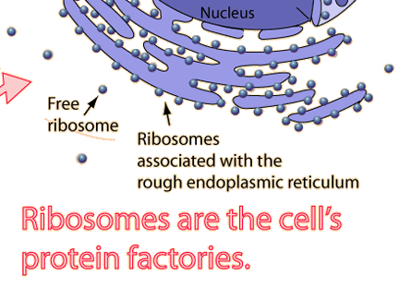
Organelles That Build Proteins
Ribosomes
Prokaryotic & Eukaryotic
can be “free” (floating in cytoplasm) or attached to ER
They make proteins
Endoplasmic Reticulum (E.R.)
Location: Eukaryotic only
Rough ER
Network of tubes; ribosomes sprinkled on surface
Move proteins made by attached ribosomes into the ERinto vesicles)
Smooth E.R.
Smooth surface; network of tubes with no ribosomes attached
Makes lipids & breaks down toxins

Slide 21
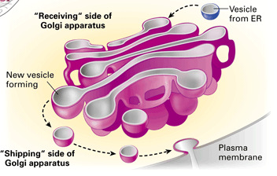
Organelles That Build Proteins
Golgi Apparatus –Packaging & Distribution
Location: Eukaryotic
flattened sacs; look like a stack of pancakes
Modifies & Re-packages proteins into new vesicles & sends them to the cell membrane to be released outside of the cell

Slide 22
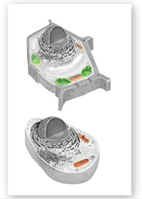
Mitochondria
Mitochondria convert chemical energy
from food into compounds the cell can use.
This process is called cellular respiration.
Notes:
Tell students: Cells need energy to carry out many processes, but can only use it in a certain form.
Tell students: Cellular respiration converts energy from food into a form cells can use. Mitochondria carry out cellular respiration.
Ask: Why are mitochondria called “powerhouses” of the cell?
Answer: They make energy available from food to fuel cell activities.
Some students may think that mitochondria are found only in animal cells and chloroplasts are found only in plant cells.
Clarify that mitochondria are found in nearly all eukaryotes, including plants.
Have students trace a meal of their own back to photosynthesis and cellular respiration (chloroplasts and mitochondria).

Slide 23
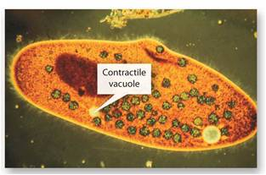
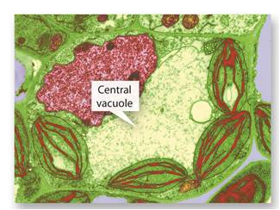
Vacuoles, Vesicles, and Lysosomes
Animal Cell
Plant Cell
Notes:
Tell students: Different types of vacuoles exist.
Click to highlight the plant vacuole.
Explain that plant cells generally have large central vacuoles whose sizes change depending on water availability.
Ask: What is likely true about the vacuoles of a wilting plant?
Answer: The vacuoles are low on water.
Explain that once the plant is watered, the vacuoles refill and the plant stands upright again.
Tell students: Look at the paramecium picture.
Click to highlight the paramecium vacuole.
Explain that a paramecium regulates water balance with its contractile vacuole.
The contractile vacuole continually fills with excess water from cytoplasm and then expels it.
Click to remove the circle.
Tell students: The smaller vesicles function to both store and transport materials within the cell and to and from the external cellular environment.
The vesicles transport materials to the cell membrane.
Activity: Ask for two volunteers to come to the front of the class. Give one student a bag or box of small items.
Give the other student a bunch of loose items into his or her hand that are not easy to hold, like a large quantity of paperclips or bouncy balls.
Have the students do a simple task, like take the items to another location in the room.
Ask: Why is it better for a cell to transport materials using vesicles than without?
Answer: Vesicles keep materials segregated from one another, contained and tidy, and prevents things from interacting that should not.
Other answers may be reasonable.
Tell students: Lysosomes break down lipids, carbohydrates, and proteins into small molecules that can be used by the rest of the cell.
They are also involved in breaking down organelles that have outlived their usefulness.

Slide 24
Vacuoles, Vesicles, and Lysosomes
Lysosomes: break down lipids, carbohydrates, and proteins into small molecules that can be used by the rest of the cell.
They are also involved in breaking down organelles that have outlived their usefulness.
Vesicles: small pods that transport substances around the cell.
Notes:
Tell students: Different types of vacuoles exist.
Click to highlight the plant vacuole.
Explain that plant cells generally have large central vacuoles whose sizes change depending on water availability.
Ask: What is likely true about the vacuoles of a wilting plant?
Answer: The vacuoles are low on water.
Explain that once the plant is watered, the vacuoles refill and the plant stands upright again.
Tell students: Look at the paramecium picture.
Click to highlight the paramecium vacuole.
Explain that a paramecium regulates water balance with its contractile vacuole.
The contractile vacuole continually fills with excess water from cytoplasm and then expels it.
Click to remove the circle.
Tell students: The smaller vesicles function to both store and transport materials within the cell and to and from the external cellular environment.
The vesicles transport materials to the cell membrane.
Activity: Ask for two volunteers to come to the front of the class. Give one student a bag or box of small items.
Give the other student a bunch of loose items into his or her hand that are not easy to hold, like a large quantity of paperclips or bouncy balls.
Have the students do a simple task, like take the items to another location in the room.
Ask: Why is it better for a cell to transport materials using vesicles than without?
Answer: Vesicles keep materials segregated from one another, contained and tidy, and prevents things from interacting that should not.
Other answers may be reasonable.
Tell students: Lysosomes break down lipids, carbohydrates, and proteins into small molecules that can be used by the rest of the cell.
They are also involved in breaking down organelles that have outlived their usefulness.

Slide 25
Cytoskeleton
Notes:
Tell students: Look at the figure.
Explain that cells have an extensive network of filaments in the cytoplasm called the cytoskeleton.
Microfilaments (pale purple) and microtubules (yellow) are two of the principal protein filaments that make up the cytoskeleton.
Microfilaments are threadlike structures made up of a protein called actin.
They form extensive networks in some cells and produce a tough, flexible framework that supports the cell. Microfilaments also help cells move.
Tell students: The cytoskeleton not only forms cell shape and framework but also acts like a highway in the cell, moving materials and organelles to the appropriate locations. In other words, the cellular components are not a random combination of things floating around in the cell, but are rather placed deliberately and moved along specific pathways.

Slide 26
Cytoskeleton
Cytoskeleton: an extensive network of filaments in the cytoplasm called the cytoskeleton.
Microfilaments (pale purple) and microtubules (yellow) are two of the principal protein filaments that make up the cytoskeleton.
Microfilaments are threadlike
structures made up of a protein
called actin.
They form extensive networks in
some cells and produce a tough,
flexible framework that supports
the cell. Microfilaments also help
cells move.
Notes:
Tell students: Look at the figure.
Explain that cells have an extensive network of filaments in the cytoplasm called the cytoskeleton.
Microfilaments (pale purple) and microtubules (yellow) are two of the principal protein filaments that make up the cytoskeleton.
Microfilaments are threadlike structures made up of a protein called actin.
They form extensive networks in some cells and produce a tough, flexible framework that supports the cell. Microfilaments also help cells move.
Tell students: The cytoskeleton not only forms cell shape and framework but also acts like a highway in the cell, moving materials and organelles to the appropriate locations. In other words, the cellular components are not a random combination of things floating around in the cell, but are rather placed deliberately and moved along specific pathways.

Slide 27
Microtubules
Microtubules: hollow structures made up of proteins known as tubulins.
play critical roles in maintaining cell shape. In animal cells, centrioles are also formed from tubulins. Centrioles are not found in plant cells.
Microtubules also help build projections from the cell surface, known as cilia and flagella (help with cell movement).
Notes:
Tell students: Microtubules are hollow structures made up of proteins known as tubulins. In many cells, they play critical roles in maintaining cell shape. Microtubules form the mitotic spindle during cell division. In animal cells, centrioles are also formed from tubulins. Centrioles are not found in plant cells.
Microtubules also help build projections from the cell surface, known as cilia and flagella.
This is a cross-section of a flagellum showing the 9+2 arrangement of microtubules.
Click to highlight the cross-section.

Slide 28
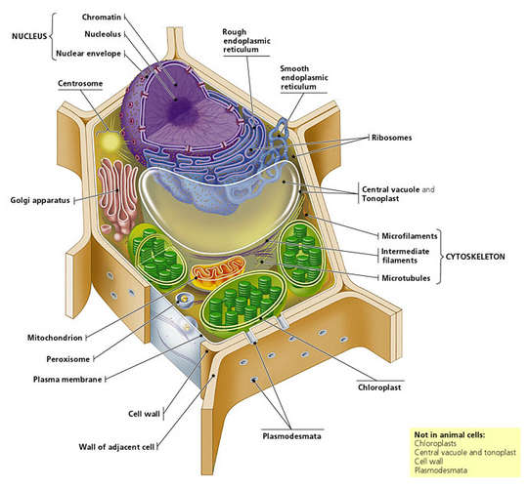
Structures of Plant Cells
Plant cells are also eukaryotic cells; they have 3 additional structures that are NOT found in animal cells
Cell wall – Location: Plant cells ONLY
S: thick wall that surrounds the cell membrane; make of cellulose
F: helps support the shape of a plant cell, protects the cell from damage, & connects it with neighboring cells
Chloroplasts – Location: Plant cells ONLY
S: Green pods containing stacks of thylakoids
F: use sunlight to make carbohydrates from carbon dioxide (CO₂) and water (H₂O)
Central Vacuole – Location: Plant cells ONLY
S: large, membrane-bound sac that takes up most of the cell’s space
F: stores water, nutrients, ions, and wastes

Slide 29
Cellular Boundaries
Cell Membranes
Cell Walls
Notes:
Ask: Consider what happens when a property owner puts up a fence. What purpose does the fence serve? How do people get in and out? Are there different kinds of fences?
Sample answer: The fence keeps people and animals out of the yard and can also keep people and animals from leaving the yard. People enter and exit through a gate. There are many types of fences.
Explain that a cell’s contents are also confined within a barrier.
Ask: Which cells have cell walls, and where are cell walls located in cells?
Answer: Plant cells and prokaryotes have cell walls.
Ask: True or false: All cells have a cell membrane.
Answer: true
Click to reveal the label for cell membranes.
Ask: True or false: All cells have a cell wall.
Answer: false
Click to reveal the label for cell walls.

Slide 30
Cell Membranes
Notes:
Tell students: The cell membrane regulates what enters and leaves the cell and also protects and supports the cell.
The membrane only allows certain things to cross it. Scientists call this semipermeable.
Tell students: Look carefully at the picture of the membrane.
Point out the inside and outside of the cell labels.
Click to highlight.
Tell students: The picture shows only a tiny part of a cell membrane, similar to the membrane that surrounds the cell in the micrograph.
Explain that the illustration is a cross section.
Model a cross section by cutting a lemon or orange in half and showing how the cut reveals a cross section of the rind.
Point out that, in the “whoosh” in the illustration, the phospholipid molecule is an enlargement of one tiny part of the cross section of the membrane.
Tell students: The phospholipid molecule in the cell membrane has two distinct ends.
Click to highlight.
Tell students: One end, the hydrophilic end is electrically attracted to water molecules.
Click to highlight the ends.
On the other end, the hydrophobic end, the phospholipid molecule repels water.
Explain how phospholipids move and slide past one another in the membrane.
Tell students: Scientists call this the fluid mosaic model.
Click to highlight and discuss each of the following components of the membrane:
Proteins: A large variety of proteins are located within the phospholipid layer. Functions include assisting materials into and out of the cell and receiving and transmitting messages.
Carbohydrates: are attached to the proteins, often act as “flags” identifying the cell in some specific manner
Have several students stand and form a “membrane.” Shuffle them into different places to show how the membrane is fluid.
Then add other students to act as proteins and carbohydrates. Proteins can be asked to hold up a hand. Carbohydrates can be asked to hold the hand of a protein. The entire class can participate in making a model. Be sure most of the students are phospholipids.

