Slide 1
Pedigrees

Slide 2
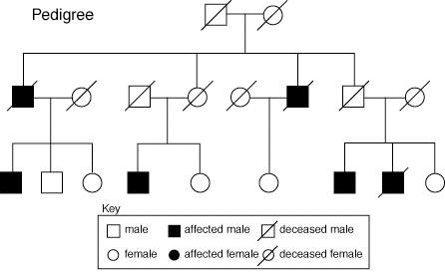
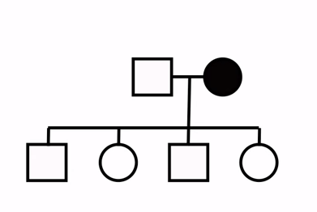
What is it?
The term “pedigree” comes from the French “pied de grue”, meaning “crane’s foot”.
A pedigree is a family record that shows how a trait is inherited over several generations.
© 2014 Vanessa Jason (“Biology Roots”)

Slide 3
Types of Traits
We have a total of 23 pairs of homologous chromosomes.
22 of these pairs are autosomal
1 of these pairs are sex chromosomes
Female pair= XX Male pair= XY
If a trait is autosomal, that means the trait is on one of the non-sex chromosomes.
If the trait is X-linked, that means the trait is on the sex chromosome X.
© 2014 Vanessa Jason (“Biology Roots”)

Slide 4
Homologous Chromosomes
Recall that we have TWO versions of a gene called alleles.
Why two?
One is inherited from mom; one is inherited from dad
The alleles are found on homologous chromosomes.
Our genes are found on our chromosomes. Genes are segments of DNA.
The chromosomes may contain different alleles (heterozygous), or they may be the same (homozygous)
Homologous Chromosomes
© 2014 Vanessa Jason (“Biology Roots”)

Slide 5
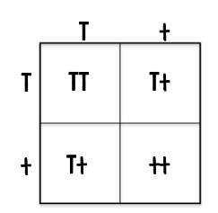
Alleles
Homologous chromosomes separate during meiosis- the offspring receives one copy of a gene from each parent.
Possible Genotypes:
TT
Tt
tt
Recessive implies that the trait will not be expressed unless the genotype is tt (using the letter t as an example).
© 2014 Vanessa Jason (“Biology Roots”)

Slide 6
Looking at Pedigrees
Circles represent females
Squares represent males
Darkened shapes represent affected individuals.
A line joining a circle and square indicates breeding.
A perpendicular line dropping from the pair indicates offspring
This particular pair had 4 offspring: 2 boys and 2 girls.
© 2014 Vanessa Jason (“Biology Roots”)

Slide 7
Looking at Pedigrees
Circles represent females
Squares represent males
Darkened shapes represent affected individuals.
tt
If the condition is autosomal, shapes can be ignored.
If the condition is sex-linked, shapes must be taken into consideration.
Since the affected individual in the example is recessive, the genotype must be tt.
© 2014 Vanessa Jason (“Biology Roots”)

Slide 8
Looking at Pedigrees
We can figure out what the genotypes of the parents are by looking at their offspring.
T
tt
?
We know that the mother must give a copy of her alleles to her kids. Since she only has the “t” allele to give, each child gets a “t”.
T T T T
t t t t
We also know that the other individuals are not affected, therefore, they must have at least one T allele.
We still cannot figure out the exact genotype of the father (TT or Tt). It remains unknown given the information.
© 2014 Vanessa Jason (“Biology Roots”)

Slide 9
Looking at Pedigrees
If the disorder is autosomal dominant, that means that the affected individuals must have at least one “T” (dominant allele).
I.
tt
T
II.
This also means that everyone not affected must have the genotype tt.
tt
T
T
tt
III.
T
tt
tt
Remember, to figure out what the genotypes of the parents are, look at their children…
Roman Numerals are used to label generations. They are necessary when there are three or more generations (more than one set of offspring).
Individuals can be numbered, as well.

Slide 10
Looking at Pedigrees
The affected son and daughter in generation II must have a “t” allele, because that is the only allele the father has to give.
I.
tt
T
t
II.
T
The same applies to the affected daughter in generation III.
t
T
tt
t
tt
III.
T
t
tt
tt
© 2014 Vanessa Jason (“Biology Roots”)

Slide 11
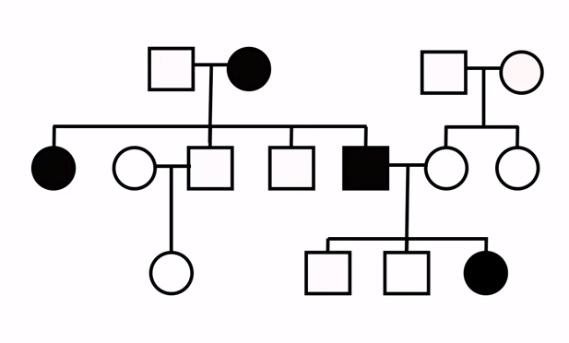
Looking at Pedigrees: X-Linked
Remember, if the trait is X-linked, you must carefully consider the shapes.
Females=
Males=
I.
X^{h}Y
X^{h}Y
X^{h}X^{h}
II.
If this is a dominant X-linked trait, how should we label the unaffected individuals?
X^{h}X^{h}
X^{h}Y
X^{h}Y
X^{h}X^{h}
X^{h}X^{h}
III.
X^{h}X^{h}
X^{h}Y
X^{h}Y
(Remember to use X and Y and superscript the allele on the X).
X^{h}Y or X^{h}X^{h}
© 2014 Vanessa Jason (“Biology Roots”)
© 2014 Vanessa Jason (“Biology Roots”)

Slide 12
Looking at Pedigrees: X-Linked
Remember, if the trait is X-linked, you must carefully consider the shapes.
Females=
Males=
Example- Sex-Linked Dominant Disorder (non- autosomal)
I.
X^{h}Y
X^{h}Y
X^{h}X^{h}
II.
If this is a dominant X-linked trait, how should we label the affected males?
X^{h}X^{h}
X^{h}Y
X^{h}Y
X^{H}Y
X^{h}X^{h}
X^{h}X^{h}
III.
X^{h}X^{h}
X^{h}Y
X^{h}Y
X^{H}Y
(males only have one X chromosome)
© 2014 Vanessa Jason (“Biology Roots”)

Slide 13
Looking at Pedigrees: X-Linked
Remember, if the trait is X-linked, you must carefully consider the shapes.
Females=
Males=
Example- Sex-Linked Dominant Disorder (non- autosomal)
I.
X^{h}Y
X^{H}
X^{h}Y
X^{h}X^{h}
II.
Affected females have at least one dominant allele
X^{H}
X^{H}
X^{h}X^{h}
X^{h}Y
X^{h}Y
X^{H}Y
X^{h}X^{h}
X^{h}X^{h}
III.
X^{h}X^{h}
X^{h}Y
X^{h}Y
X^{H}
For the second X chromosome allele, we must look at the offspring or parents.
© 2014 Vanessa Jason (“Biology Roots”)

Slide 14
Looking at Pedigrees: X-Linked
Females have two X chromosomes, therefore two X-linked alleles (unlike males, who have one).
Example- Sex-Linked Dominant Disorder (non- autosomal)
I.
What is this affected female’s second X-linked allele (Hint: Look at the offspring)
X^{h}Y
X^{H}
X^{h}
X^{h}Y
X^{h}X^{h}
II.
Males inherit X-chromosomes from their mother. Females inherit one X chromosome from mom, and one from dad.
X^{H}
X^{h}X^{h}
X^{h}Y
X^{h}Y
X^{H}Y
X^{h}X^{h}
X^{h}X^{h}
III.
X^{h}X^{h}
X^{h}Y
X^{h}Y
X^{H}
Since Female 1 in generation I has sons without the trait, and a daughter without the trait, she must carry a recessive allele to pass on to offspring!
© 2014 Vanessa Jason (“Biology Roots”)

Slide 15
Looking at Pedigrees: X-Linked
Females have two X chromosomes, therefore two X-linked alleles (unlike males, who have one).
Example- Sex-Linked Dominant Disorder (non- autosomal)
I.
Males inherit X-chromosomes from only their mothers. Females inherit one X chromosome from mom, and one from dad.
X^{h}Y
X^{H}
X^{h}
X^{h}Y
X^{h}X^{h}
II.
X^{H}
X^{h}
X^{h}X^{h}
X^{h}Y
X^{h}Y
X^{H}Y
X^{h}X^{h}
X^{h}X^{h}
III.
What is this affected female’s second X-linked allele.
X^{h}X^{h}
X^{h}Y
X^{h}Y
X^{H}
What is Female 1 in Generation II’s genotype?
In this case, we can seek the answer by looking at her father since she has no offspring. Women inherit an X chromosome from their father.
© 2014 Vanessa Jason (“Biology Roots”)

Slide 16
Looking at Pedigrees: X-Linked
I.
X^{h}Y
X^{H}
X^{h}
X^{h}Y
X^{h}X^{h}
II.
X^{H}
X^{h}
X^{h}X^{h}
X^{h}Y
X^{h}Y
X^{H}Y
X^{h}X^{h}
X^{h}X^{h}
X^{H}Y
III.
X^{h}X^{h}
X^{h}Y
X^{h}Y
X^{H}
X^{h}
What is Female 2 in Generation III’s genotype?
Again, because she has no children we can also look at her parents. She inherited the dominant X chromosome from her father. Since her mother is unaffected, she only has recessive alleles to give.
© 2014 Vanessa Jason (“Biology Roots”)

Slide 17
Pedigrees: A Puzzle
Most of the time, you are required to figure out what type of trait the pedigree is. The information is not given.
The possibilities are:
Autosomal dominant
Autosomal recessive
X-linked dominant
X-linked recessive
There are some GENERAL rules to help you figure out the possible traits...
© 2014 Vanessa Jason (“Biology Roots”)

Slide 18
Pedigree Analysis
DOMINANT OR RECESSIVE?
Do unaffected parents have affected offspring?
YES NO
1
2
Typically with cases of autosomal recessive, the trait skips generations.
Whereas in autosomal dominant traits, generations are not skipped.
(Consider this a general guideline, not a rule).
Recessive trait
Dominant trait
© 2014 Vanessa Jason (“Biology Roots”)

Slide 19
Pedigree Analysis
AUTOSOMAL OR X-LINKED: GUIDELINES
1
Do affected males have affected sons?
YES NO
2
Is the trait equally (or nearly equally) distributed among both males and females?
YES NO
Autosomal
X-linked
(Probably) Autosomal
X-linked (recessive)
(Sons inherit the Y chromosome from their father)
Guideline #2 only applies to recessive X-linked traits. IF the trait is X-linked dominant, females will express it as equally as men.

Slide 20
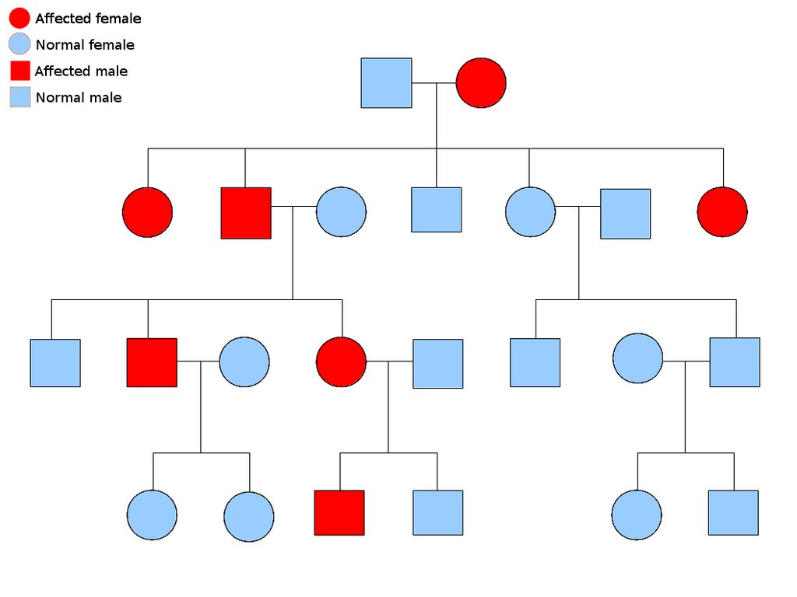
What type of inheritance does this pedigree demonstrate?
ANSWER: Autosomal Dominant
© 2014 Vanessa Jason (“Biology Roots”)

Slide 21
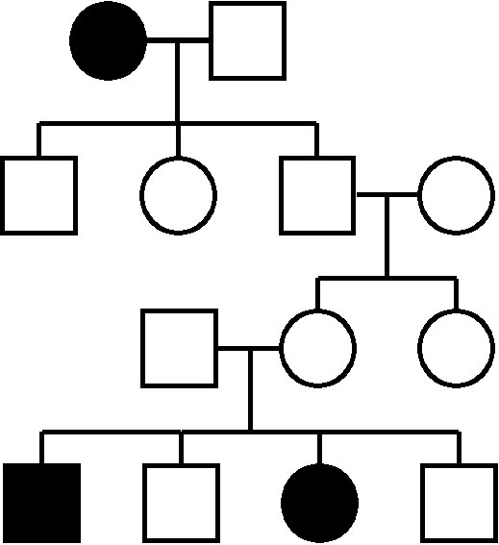
What type of inheritance does this pedigree demonstrate?
ANSWER: Autosomal Recessive
© 2014 Vanessa Jason (“Biology Roots”)

Slide 22
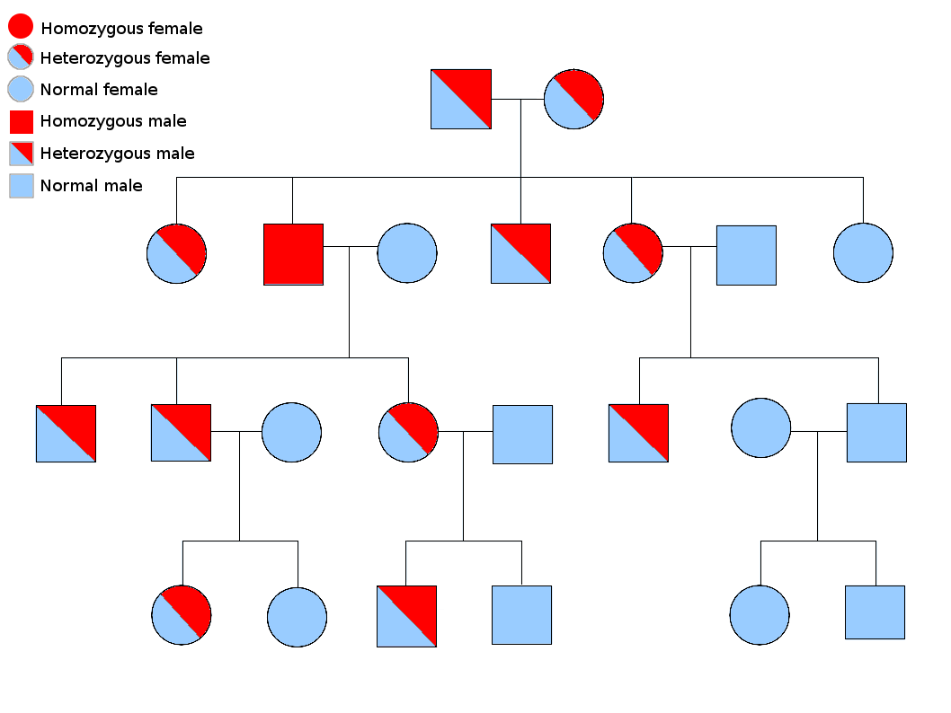
Autosomal recessive with carriers shown:
RED= recessive (aa)
BLUE= dominant (AA)
BOTH= heterozygous (Aa)
In some pedigrees, carriers, or those that are heterozygous for the trait are shown by coloring in half. This is an autosomal recessive trait in which those who are NOT affected, but carriers of the trait are colored blue (dominant allele) and red (recessive allele).

Slide 23
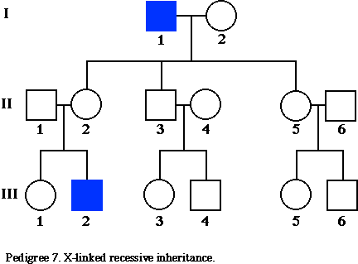
What type of inheritance does this pedigree demonstrate?
ANSWER: X-linked Recessive

Slide 24
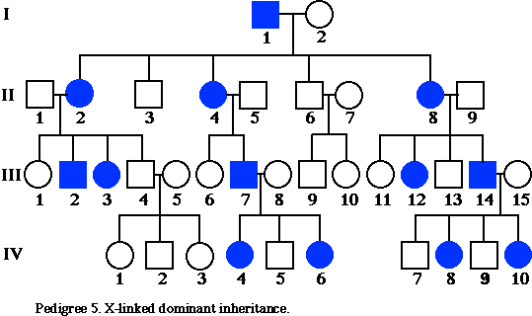
What type of inheritance does this pedigree demonstrate?
ANSWER: X-linked Dominant
Notice that in X-linked DOMINANT traits (which are very, very, rare), females and males can be equally distributed. The rule about more males having the trait usually applies if the trait is recessive- which it is MOST of the time!
BEFORE YOU PANIC IN A STATE OF CONFUSION… the other rule about X-linked traits still applies! Affected males NEVER pass the trait on to their sons. That’s the only way we could know this is X-linked.
(X-linked dominant traits are so rare, you rarely see these types of pedigrees- if you initially thought “autosomal dominant” you are thinking CORRECTLY!)
© 2014 Vanessa Jason (“Biology Roots”)

