Slide 1
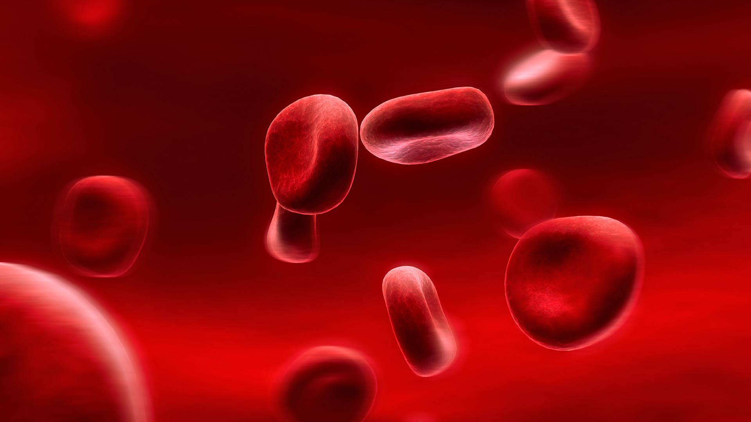
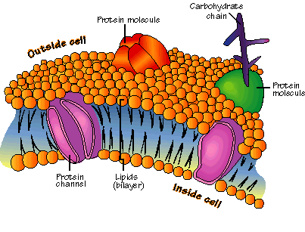
Chapter 7-3: Cell Transport

Slide 2
Daily Objectives
Explain what is meant by the term selective permeability.
Compare and contrast passive and active transport.

Slide 3
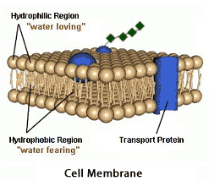
Cell Membrane
Also called “plasma membrane”
Flexible boundary between the cell and its environment
Allows a steady supply of nutrients to enter cells
Can remove excess of nutrients and wastes
Helps maintain homeostasis

Slide 4
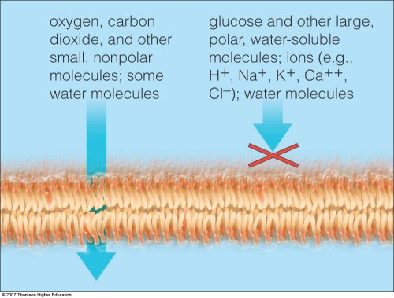
Selective Permeability
Allows some molecules into the cell while keeping others out
Think of an analogy for this

Slide 5
Analogies
__________________________________________________________________________________________________________________________________________________________________________________________________________________
___________________________________

Slide 6
Structure
Phospholipid bilayer
2 layers of phospholipids (lipids with a phosphate group attached)
Lipids have a glycerol backbone, 2 fatty acid chains, and a phosphate group
Fatty acid chains are nonpolar (avoid water)
Phosphate group heads are polar (like water)

Slide 7
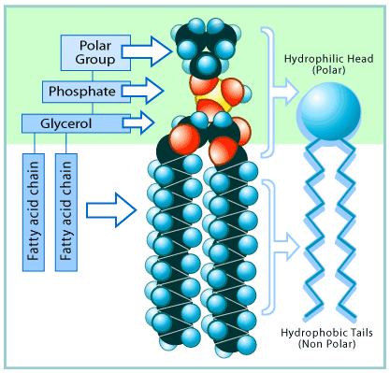
Phospholipids

Slide 8
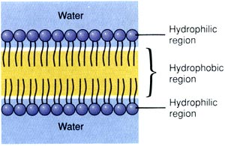
Structure
Two layers make a “sandwich”
Fatty acid tails form the inside of the membrane
Phospholipids heads face the outside of the membrane
Diagram: (draw and label)

Slide 9
Fluid Mosaic Model
Phospholipids move within the membrane like water
Membrane is flexible
Proteins within membrane create a pattern on the membrane surface
Contain proteins called transport proteins
Help regulate what can enter and leave a cell

Slide 10
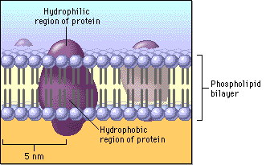
Fluid Mosaic Model

Slide 11
Diffusion
Random movement of particles from an area of higher concentration to an area of lower concentration
No energy is required
Particles move randomly (Brownian motion) and are constantly hitting each other, gathering energy (kinetic energy)
Speed of diffusion is affected by the concentration of the solution, temperature, and pressure

Slide 12
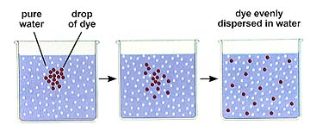
Diffusion

Slide 13
Diffusion

Slide 14
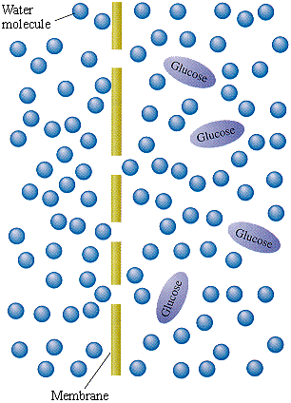
Osmosis
Diffusion of water
Water always moves to reach equilibrium (equal concentration on both sides of the membrane)
High → Low

Slide 15
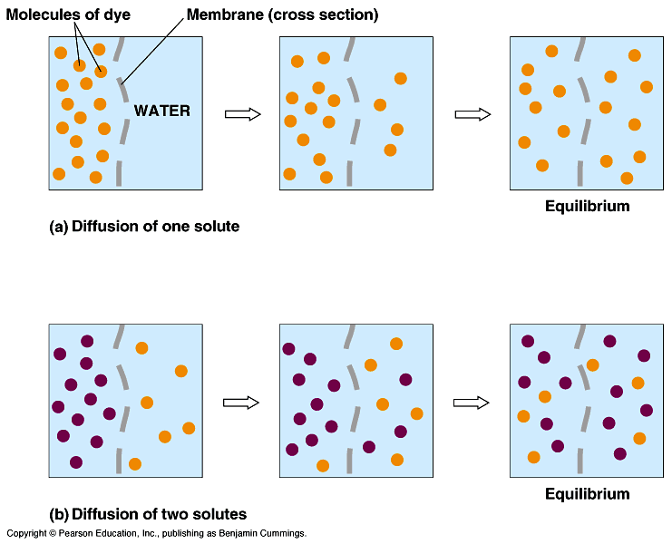
Concentration Gradient
The unequal distribution of particles
Difference in concentration of a substance across space
3 types of solutions

Slide 16
Isotonic
Concentration inside the cell is equal to the concentration outside the cell
Involves both water and dissolved substances
Water moves into and out of the cell at the same rate

Slide 17
Isotonic

Slide 18
Hypotonic
Concentration of dissolved substances is lower outside the cell than the concentration inside the cell
More water is on the outside of the cell than inside
Water will move into the cell
Cell will swell and cell pressure will increase
Too much swelling can cause cell to burst (in animal cells only)

Slide 19
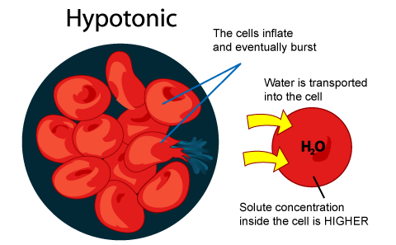
Hypotonic

Slide 20
Hypertonic
Concentration of dissolved substances is higher outside the cell than inside the cell
Water will flow out of the cell
Cell will shrivel and cell pressure decreases

Slide 21
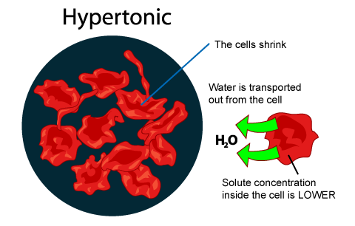
Hypertonic

Slide 22
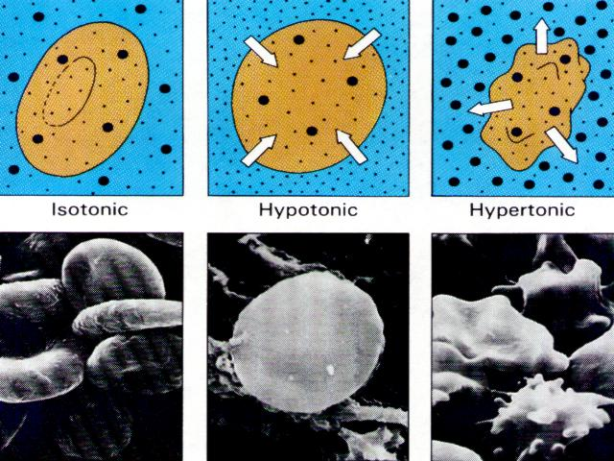
3 Types of Solutions

Slide 23
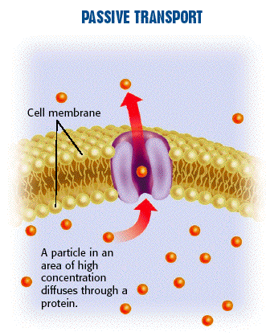
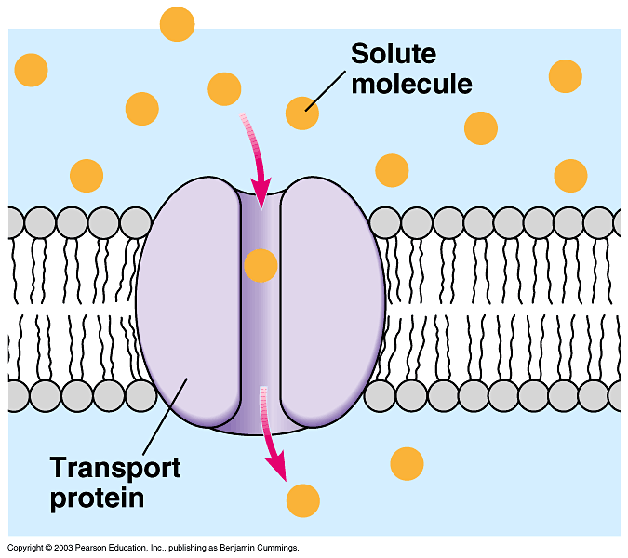
Passive Transport
Cell uses no energy to move particles across a membrane.
Transport proteins: provide openings for particles to pass through
Help substances move through plasma membrane (larger substances)

Slide 24
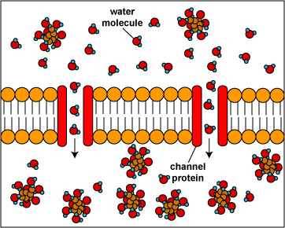
Channel Proteins
Form channels that allow specific molecules to flow through
Ex: Ions and small dissolved particles
No energy is needed

Slide 25
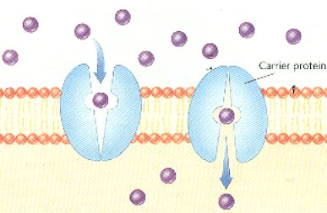
Carrier Proteins
Change shape to allow substances to pass through
No energy is needed

Slide 26
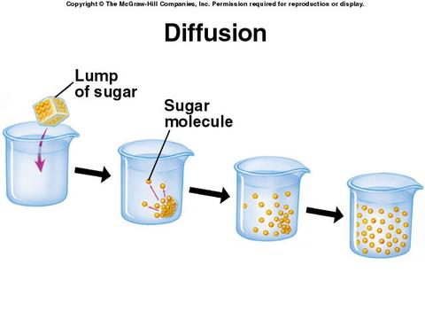
2 Types of Passive Transport
Simple diffusion: Does not use transport proteins
Facilitated Diffusion: Uses transport proteins to help materials move across the membrane
Helps move larger molecules (sugar, salt, ions)

Slide 27
Active Transport
Moving particles from a region of lower concentration to an area of higher concentration (Low → High)
Needs energy to go against the concentration gradient
Uses carrier proteins- Binds with particles and then changes shape to release on the other side of the membrane

Slide 28
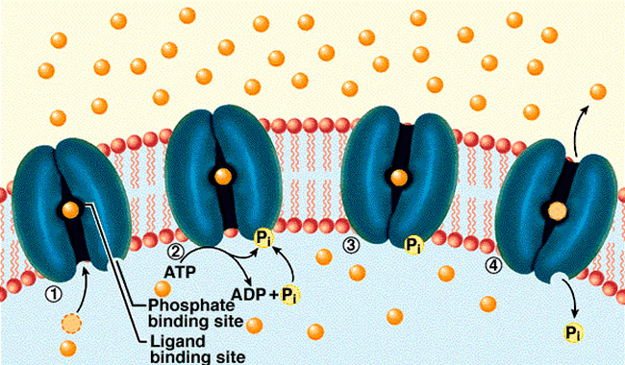
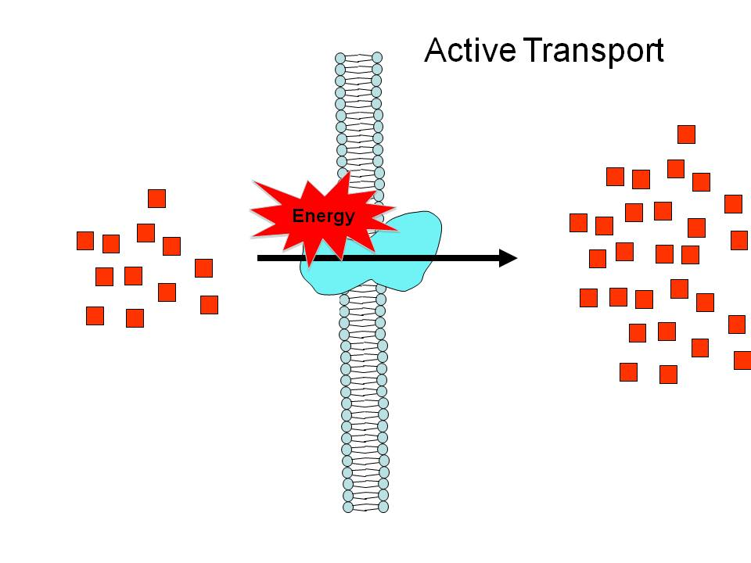
Active Transport

Slide 29
Bulk Transport
Both require energy
Endocytosis: A cell surrounds and takes in material from its environment
Material is engulfed and enclosed by part of the cell membrane
2 types:
Phagocytosis
Solid materials
Pinocytosis
Liquid materials

Slide 30
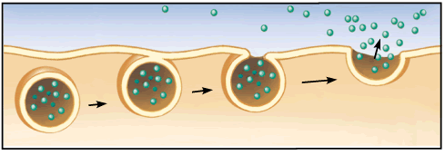
Bulk Transport
Exocytosis: expulsion or secretion of materials from a cell
Ex: Wastes and Hormones

