Slide 1
Chapter 7: Meiosis & Sexual Reproduction

Slide 2
Section 1: Meiosis
REMEMBER!!
Gametes are egg and sperm
Gametes are haploid which means they have only one set of chromosomes. (23 in humans)
Meiosis – formation of gametes only; original parent cell is diploid, and by the end of meiosis there are 4 daughter cells produced that are haploid.
[It is a 2-part cell division]

Slide 3
Steps of Meiosis
In Meiosis, PMAT is completed 2 times, making 8 steps total.
That means Meiosis takes twice as much time as Mitosis.

Slide 4
Section 1: Meiosis

Slide 5
Section 1: Meiosis
Meiosis begins with Homologous Chromosomes
Meiosis I
Main idea: separate homologous chromosomes from one another.

Slide 6
Section 1: Meiosis
Prophase I = chromosomes become visible, nuclear membrane breaks down; crossing-over occurs; tetrads form.
Homologous chromosomes that each have 2 chromatids;
4 chromatids total!

Slide 7
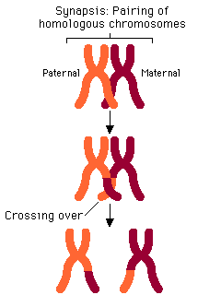
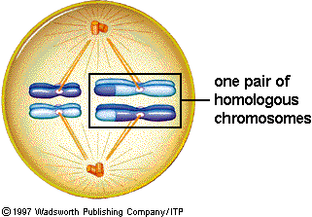
Section 1: Meiosis
Crossing-over – portions of a chromatid on 1 homologous chromosome are broken & exchanged with the corresponding chromatid portions of the other homologous chromosome

Slide 8
Section 1: Meiosis
Metaphase I – pairs of chromosomes (tetrads) move to the middleof the cell

Slide 9
Section 1: Meiosis
Anaphase I – homologous chromosomes are separated and move to opposite ends of the cell
Chromatids DO NOT separate at the centromeres!

Slide 10
Section 1: Meiosis
Telophase I & Cytokinesis – chromosomes gather at the poles of the cell; cytoplasm divides.
Both resulting cells contain 1 chromosome from each pair of homologous chromosomes (tetrad).

Slide 11
Section 1: Meiosis
Main Idea of Meiosis II:
Division of chromatids
Prophase II – new spindle forms around chromosomes; start with the two cells created in meiosis I
vs.

Slide 12
Section 1: Meiosis
Metaphase II – chromosomes line up in the middle of the cell
Anaphase II – centromeres divide and sister chromatids move apart to opposite poles of the cell

Slide 13
Section 1: Meiosis
Telophase II & Cytokinesis – nuclear envelope (nucleus) forms around each set of chromosomes; cytoplasm divides
The end result of Meiosis = 4 HAPLOID CELLS with 23 chromosomes each.

Slide 14
Section 1: Meiosis
Three main ideas make all humans different from one another. This is called genetic variation.
Independent Assortment
Crossing Over
Random Fertilization

Slide 15
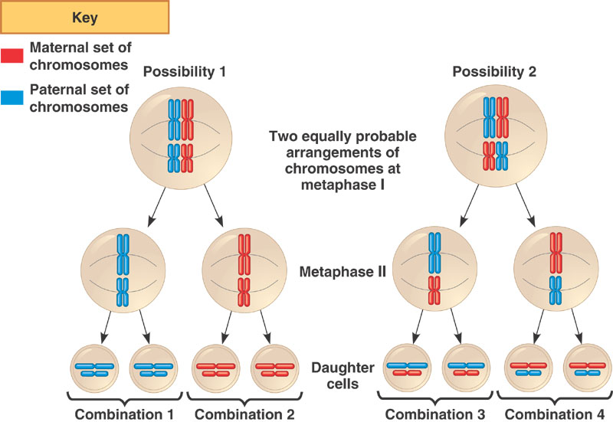
Section 1: Meiosis
Independent Assortment – random distribution of homologous chromosomes during meiosis

Slide 16
Section 1: Meiosis
Crossing – over – DNA exchange between homologous chromosomes

Slide 17
Section 1: Meiosis
Random Fertilization – fertilization of an egg by a sperm is random, increasing the number of possible outcomes

Slide 18
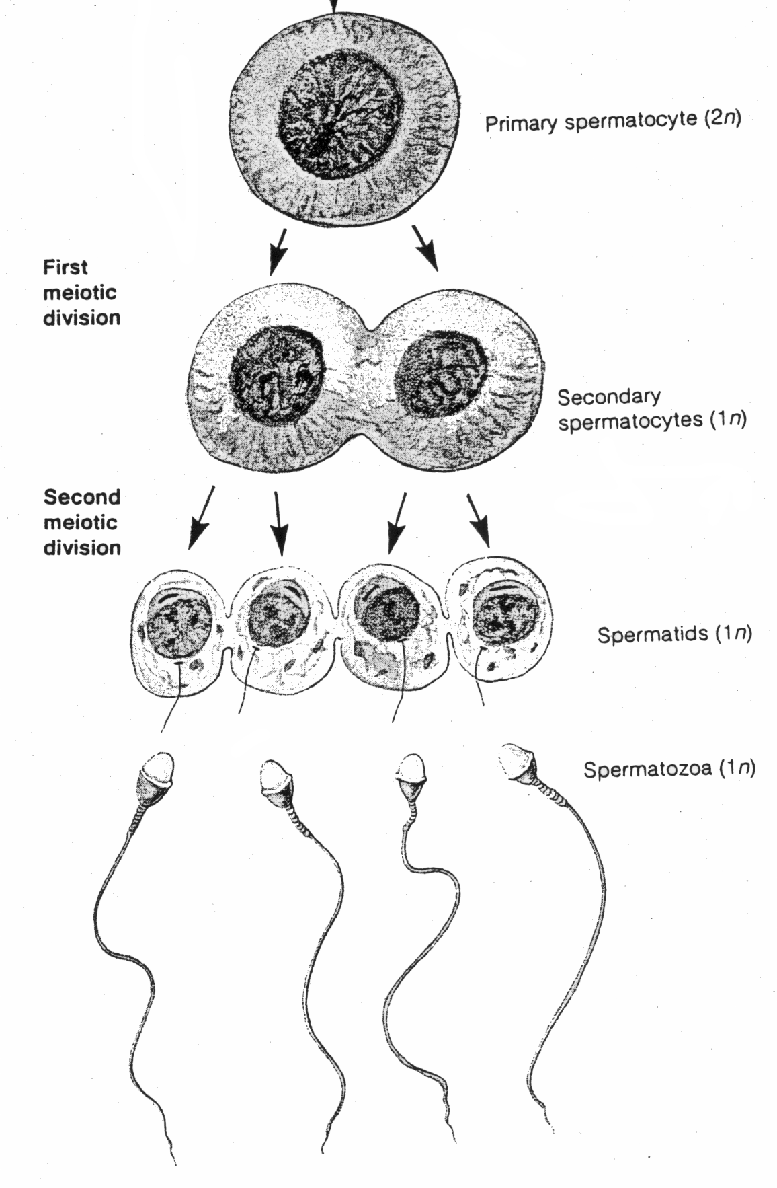
Gametogenesis – formation of gametes
Spermatogenesis – process by which sperm are produced; meiosis for males
Of the 4 cells produced, all 4
are functioning sperm cells

Slide 20
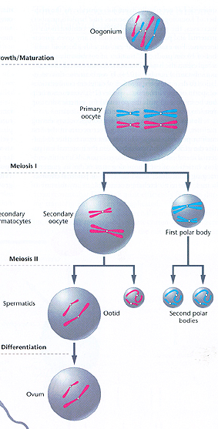
Section 1: Meiosis
Oogenesis – (pronounced oh-a-genesis) process by which egg cells (ovum/ova) are produced.
One cell gets most of the cytoplasm, and the other 3 (polar bodies) die.
Polar bodies – small, nonfunctional cells that result from uneven division of the cytoplasm

Slide 21
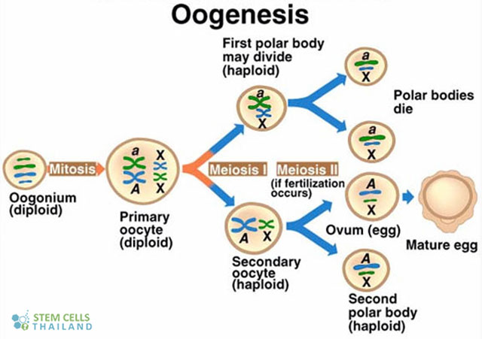

Slide 22
Mitosis vs. Meiosis
Mitosis
Meiosis
2n
2n
2n
2n
n
n
n
n
n
n

Slide 23
Section 2: Sexual Reproduction
Reproduction - process of making offspring
Sexual reproduction – two parents form reproductive cells (haploid) that join to form a diploid offspring
Asexual reproduction – single parent passes copies of all of it genes to each of its offspring
There is no fusion of haploid cells (gametes)

Slide 24
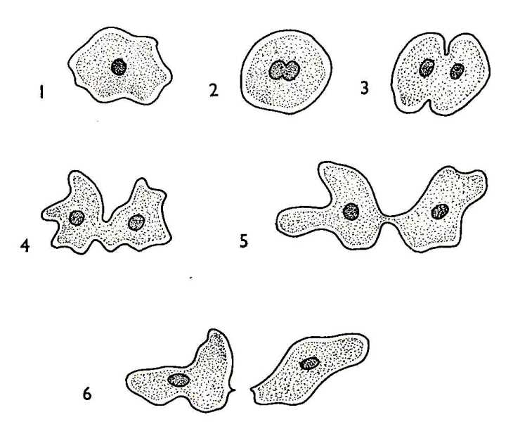
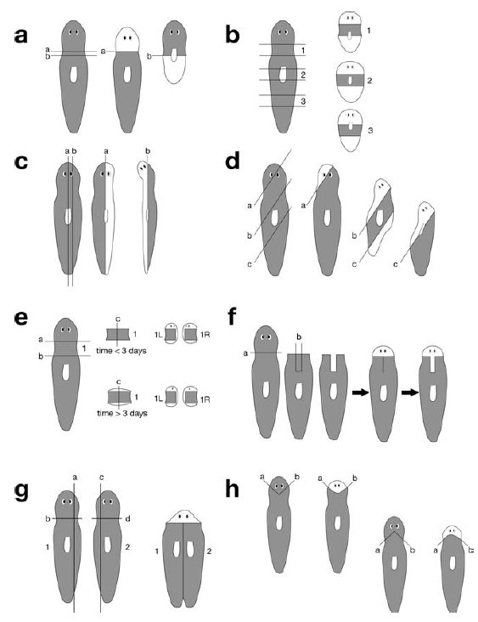
Section 2: Sexual Reproduction
Types of Asexual Reproduction:
Fission – the separation of the parent cell into two or more individuals
Fragmentation – the body breaks into several pieces; each piece develops into adults—ex. Sponges, coral, some plants

Slide 25
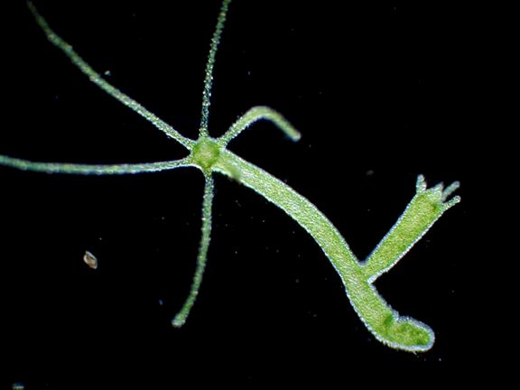
Section 2: Sexual Reproduction
Budding – individuals split off from existing ones; the bud may break off and become an independent organism
ex. Bacteria and yeast

