Slide 1

Is It Dead Or Alive?
By: Diantha Smith

Slide 2
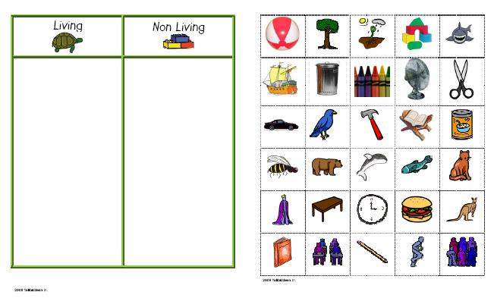
What do you think?
Sort the items on your guided notes.

Slide 3
Back to Sammy….
Think back to our story about Sammy. Reflect on your responses to the questions.
What are some qualities of living things that we can all agree on?
  How many can you think of that apply to ALL living things?

Slide 4
Qualities of Living Things
In order to be classified as “Living” the organism must have the following qualities:
  1. Made of basic units called cells
  2. Have a genetic code
  3. Reproduce
  4. Grow and develop
  5. Energy and metabolism
  6. Respond to stimuli
  7. Maintain homeostasis
  8. Evolve

Slide 5
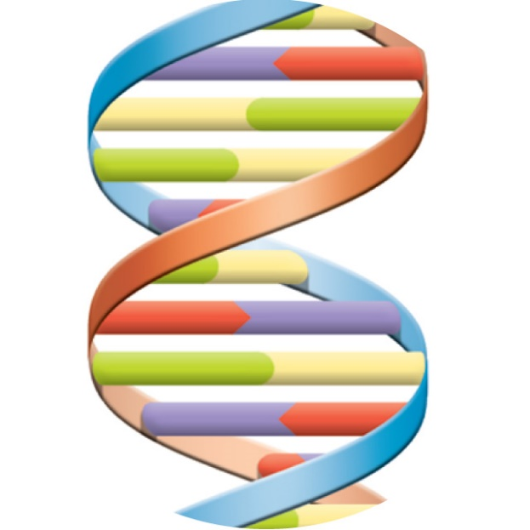
Qualities of Living Things
Cells
  Smallest units of an organism (living thing) that can be considered “alive”
  Complex; highly organized
  Self-contained units
  More on cells later on ☺
Genetic Code
  DNA carries a genetic code; it dictates how organisms inherit traits

Slide 6
Qualities of Living Things
Reproduction
  All living things are able to produce new living things
  2 types of reproduction
    1. Sexual Reproduction
    2. Asexual Reproduction
Sexual Reproduction
  Vast majority of multicellular organisms reproduce this way.
  2 parents
  Parents and offspring differ
Asexual Reproduction
  Used by many single-celled organisms such as bacteria; some fungi and plants reproduce this way
  1 parent
  Parent and offspring have the same traits; genetic clones

Slide 7
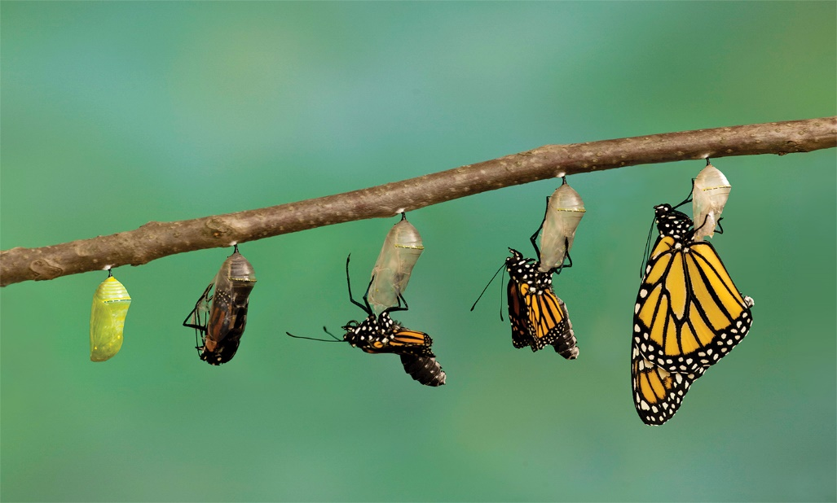
Qualities of Living Things
Growth & Development
  Could be simply an increase in size, or adding structures to itself to become more complex
Energy & Metabolism
  Living things use energy and materials to stay alive.
  Metabolism—the combo of chemical reactions used by a living thing to carry out life processes

Slide 8
Qualities of Living Things
Response to Stimuli
  Living things are able to respond to a stimulus (a signal) both in the environment or internally.
  For example, plants need sunlight to grow. A plant in a window will grow toward the sun. Sometimes, the plant will grow unevenly in order to get as much sunlight as possible. Sunlight is a stimulus, and the plant is responding to it.
Maintaining Homeostasis
  Living things must maintain a relatively stable set of internal conditions. This is called homeostasis.
  For example, your body needs to stay at a certain temperature to function. If the temperature gets too high, your body responds and begins to sweat to lower the temperature to normal. Similarly, if the body temp drops too low, your body shivers to create motion to raise the temperature.

Slide 9
Qualities of Living Things
Evolution
  Over time, living things must have the ability to change.
  This is not a trait that changes from parent to offspring, rather, a change that could occur over hundreds of thousands of years within a species.

Slide 10
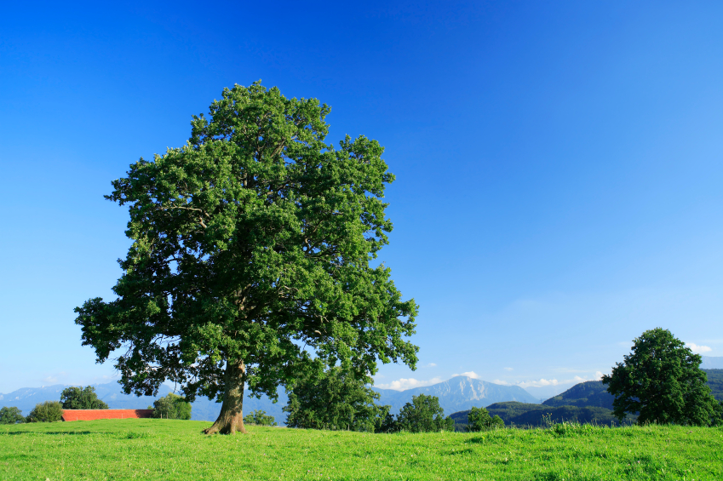
Is a tree alive?
  Is it made of basic units called cells?
  Does it a genetic code?
  Does it reproduce?
  Does it grow?
  Does it use energy?
  Does it respond to stimuli
  Does it maintain homeostasis?
  Does it evolve
YES

Slide 11
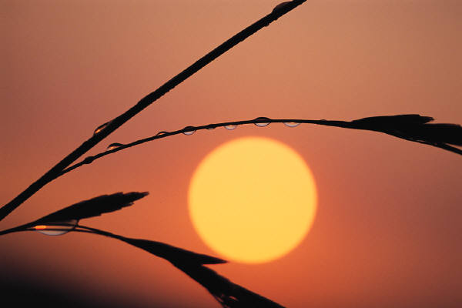
Is the sun alive?
  Is it made of basic units called cells?
  Does it a genetic code?
  Does it reproduce?
  Does it grow?
  Does it use energy?
  Does it respond to stimuli
  Does it maintain homeostasis?
  Does it evolve
NO

Slide 12
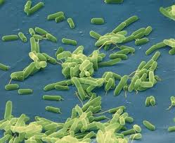
Are bacteria (germs) alive?
  Is it made of basic units called cells?
  Does it a genetic code?
  Does it reproduce?
  Does it grow?
  Does it use energy?
  Does it respond to stimuli
  Does it maintain homeostasis?
  Does it evolve
YES

Slide 13
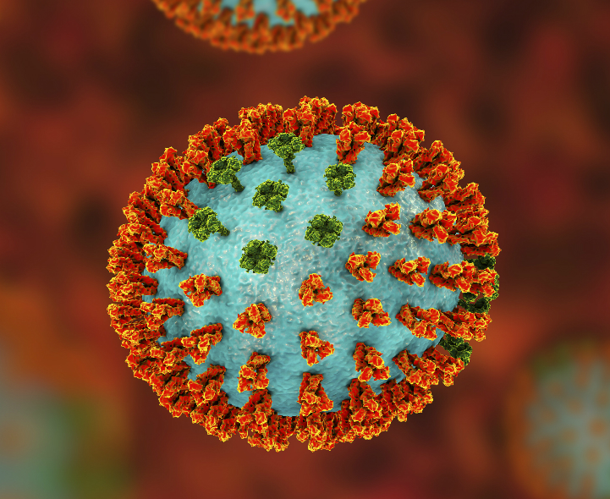
Are viruses alive?
  Is it made of basic units called cells?
  Does it a genetic code?
  Does it reproduce?
  Does it grow?
  Does it use energy?
  Does it respond to stimuli
  Does it maintain homeostasis?
  Does it evolve
But what IS a virus?

Slide 14
Viruses
What is a virus?
segments of nucleic acids inside a protein coat.
Viruses are NOT living cells.
They are smaller than prokaryotes (bacteria).
They are pathogens – agents that cause disease.
Viruses replicate by invading a host cell.
They do not grow, maintain homeostasis, or metabolize.

Slide 15
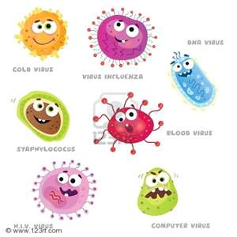
Viral Diseases
Common Cold
Hepatitis
Mumps
Rabies
SARS
Smallpox
Mononucleosis (Mono)
COVID-19
Viral diseases can’t be cured. Only the symptoms can be treated.

Slide 16
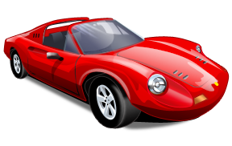
Is a car alive?
  Is it made of basic units called cells?
  Does it a genetic code?
  Does it reproduce?
  Does it grow?
  Does it use energy?
  Does it respond to stimuli
  Does it maintain homeostasis?
  Does it evolve
NO

Slide 17
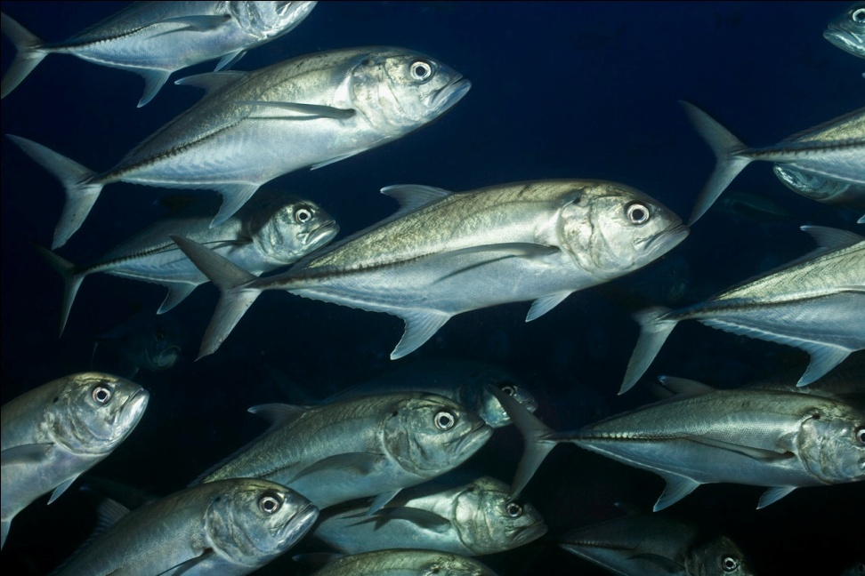
Is a fish alive?
  Is it made of basic units called cells?
  Does it a genetic code?
  Does it reproduce?
  Does it grow?
  Does it use energy?
  Does it respond to stimuli
  Does it maintain homeostasis?
  Does it evolve
YES

Slide 18
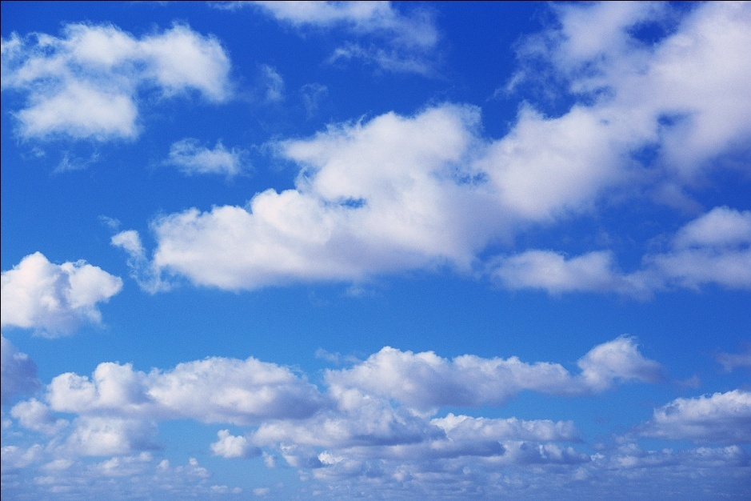
Is a cloud alive?
  Is it made of basic units called cells?
  Does it a genetic code?
  Does it reproduce?
  Does it grow?
  Does it use energy?
  Does it respond to stimuli
  Does it maintain homeostasis?
  Does it evolve
NO

