Slide 1
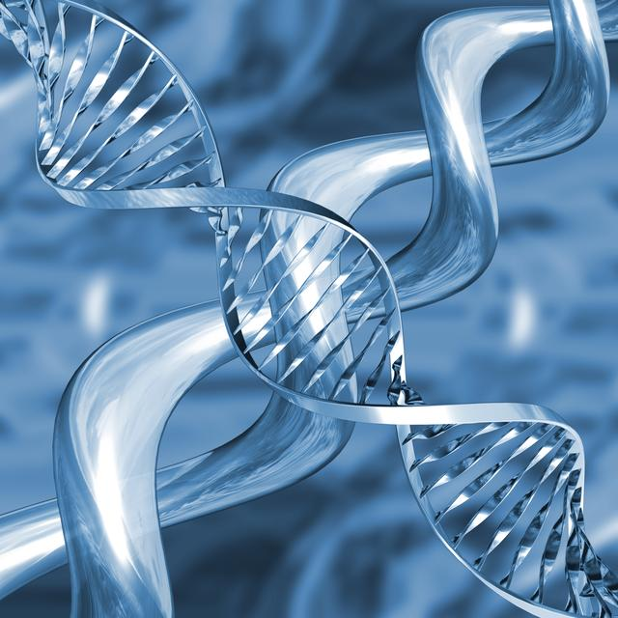
Chapter 9 DNA: The Genetic Material

Slide 2
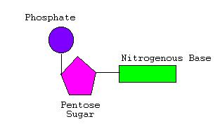
Section 2: The Structure of DNA
DNA = deoxyribonucleic acid
Double helix – two strands twisted around each other (twisted ladder; winding staircase)
Nucleotides – the subunits that make up DNA
3 Parts:
5-carbon sugar (deoxyribose)
Nitrogen base
Phosphate group

Slide 3
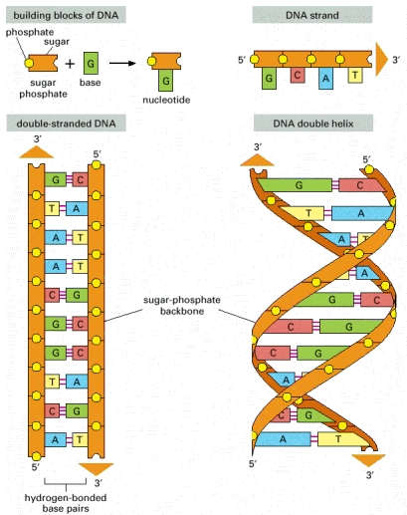
Section 2: The Structure of DNA
What holds the two strands together?
Hydrogen Bonds!!!

Slide 4
Section 2: The Structure of DNA
There are 4 different types of nitrogen bases:
Adenine (A)
Guanine (G)
Thymine (T)
Cytosine (C)
Purines – made up of 2 fused rings
Pyrimidines - made up of only 1 ring

Slide 5
Section 2: The Structure of DNA
Base Pairing Rules:
Purines pair with pyrimidines.
A – T & C – G
(apple in the tree) (car in the garage)
Practice: ATTAGACTAG
Fill in the strand that is complementary to what is shown
TAATCTGATC

Slide 6
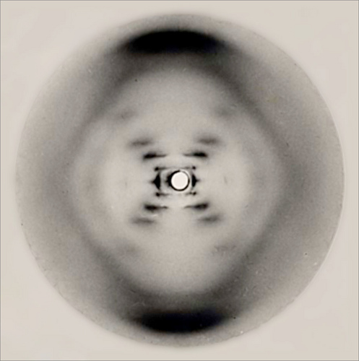
Section 2: The Structure of DNA
Work that Lead Up to Watson & Crick:
Erwin Chargaff – 1949, American biochemist observed that the amount of A = T and the amount of G = C ……base-pairing rules!
Wilkins & Franklin - 1952, worked with X-ray diffraction photos; researched the structure of DNA using “Photo 51” at right.

Slide 7
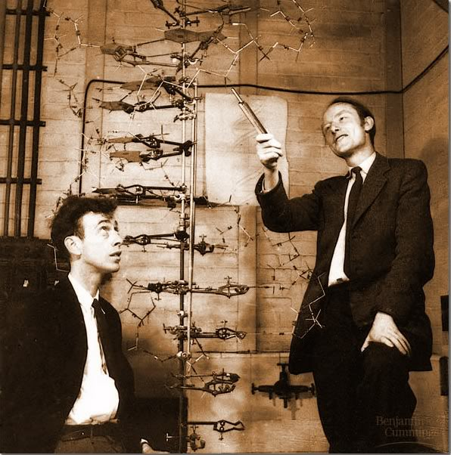
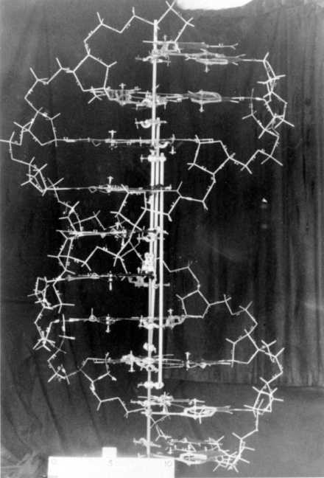
Section 2: The Structure of DNA
Watson & Crick – in 1953, two English researchers pieced together the first 3-D model of DNA using Chargaff’s findings and Wilkins & Franklins X-ray diffraction photos
Importance = clarified how DNA serves as the genetic material

Slide 8
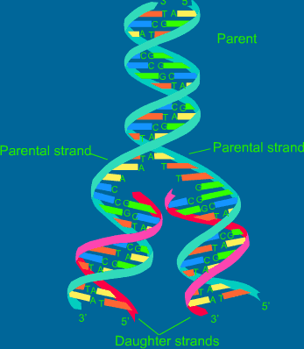
Section 3: The Replication of DNA
DNA replication – the process of making a copy of DNA
When does DNA replication happen during a cell’s life?
- Synthesis (S) phase of
Interphase (Cell Cycle)

Slide 9
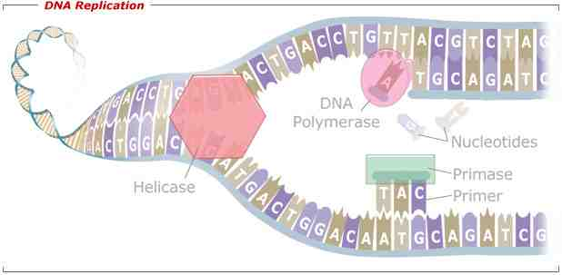
Section 3: The Replication of DNA
Double helix unwinds (unzips) with the help of DNA Helicase by breaking the hydrogen bonds. The two strands are held apart by the replication fork.

Slide 10
Section 3: The Replication of DNA
DNA polymerases add nucleotides to the exposed nitrogen bases – it fills in the complementary strands
Two DNA molecules form that are identical to the original DNA molecule.

Slide 11
Section 3: The Replication of DNA
Proofreading – DNA polymerase adds nucleotides to a growing strand only if the previous nucleotide is correct.
- if there is a mistake, the DNA polymerase will backtrack, remove the incorrect nucleotide, and replace it with a correct one.

Slide 12
Ch. 10: How Proteins are Made

Slide 13
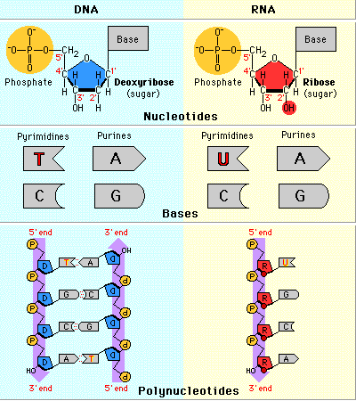
Section 1:From Genes to Proteins
Decoding the information in DNA:
RNA = ribonucleic acid; single strand of nucleotides
DNA
2 strands of nucleotides
Sugar = deoxyribose
RNA
1 strand of nucleotides
Sugar = ribose
4 Nitrogen Bases:
A, G, C, & T
4 Nitrogen Bases:
A, G, C, & U
Uracil (U) replaces thymine (T) in RNA.
RNA Base-Pairing Rules:
A-U & G-C

Slide 14
Section 1: From Genes to Proteins
Transcription – the instructions for making a protein are transferred from a gene (DNA) to a strand of RNA
* occurs in the nucleus
Translation – two different types of RNA read the instructions on the RNA from transcription and put together amino acids to make a protein
*occurs in the cytoplasm (on a ribosome)

Slide 15
Section 1: From Genes to Proteins
Three steps of Transcription:
RNA polymerase binds to a gene’s promoter (start signal)
The 2 DNA strands unwind & separate
Complementary RNA nucleotides are added (mRNA is made)
mRNA = messenger RNA = carries the instructions for making a protein; delivers the info. to the site of translation

Slide 16
Section 1: From Genes to Proteins
RNA instructions are written as a series of three-nucleotide sequences on the mRNA = codons
ACC GAT TAT GTA
Each codon on the mRNA corresponds to an amino acid:
UGG = Tryptophan; CUA = Leucine; AUA = Isoleucine; CAU = Histidine
UGG CUA AUA CAU

Slide 17
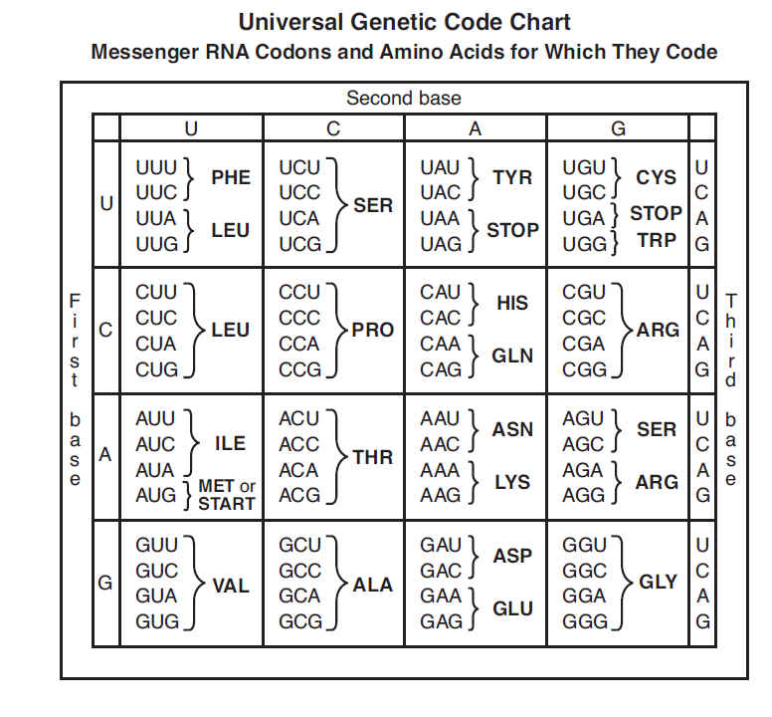

Slide 18
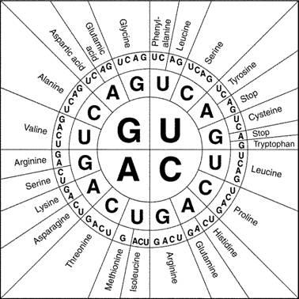

Slide 19
Section 1: From Genes to Proteins
AUG = start codon (methionine)
UAA, UAG, & UGA = stop codons
tRNA – transfer RNA – carries an amino acid to its correct codon
Amino acid
An amino acid on tRNA corresponds to a codon on mRNA.
tRNA
Anticodons

Slide 20
Section 1: From Genes to Proteins
Anticodons – three-nucleotide sequence on tRNA that is complementary to the codons on mRNA
rRNA – make up part of the structure of a ribosome
Each ribosome temporarily holds one mRNA and two tRNA molecules.

Slide 21
Steps of Translation
The ribosomal subunits, the mRNA, and the tRNA carrying methionine bind together.
The tRNA carrying the amino acid specified by the codon in the A site arrives.
A peptide bond forms between adjacent amino acids.
The tRNA in the P site detaches and leaves its amino acid behind.

Slide 22
The tRNA in the A site moves to the P site. The tRNA carrying the amino acid specified by the codon in the A site arrives.
A peptide bond is formed. The tRNA in the P site detaches and leaves its amino acid behind.
The process is repeated until a stop codon is reached. The ribosome complex falls apart. The newly made protein is released.

Slide 23
Mutations – changes in the DNA
Original DNA: CTGGAG
A few basic types:
Point Mutation (Substitution) – exchange of one base for another (ex: CTGGTG).
Insertion – extra base pairs are inserted into a new place in the DNA (ex: CTGGTGGAG).
Deletion – a section of DNA is lost (ex: CTAG)
Frameshift – insertions and deletions can alter a gene so that its message is no longer read correctly (The fat cat sat ----> )
hef atc ats at

