Slide 1
Chapter 8 Mendel & Heredity

Slide 2
Section 1: The Origin of Genetics
Genetics – branch of biology that focuses on heredity
Heredity – the passing of traits from parents to offspring

Slide 3
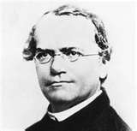
Section 1: The Origin of Genetics
Gregor J. Mendel = “The Father of Genetics”
Mendel’s Work:
Studied garden peas
Crossed purple pea plants with white pea plants ─› all offspring were purple
Cross – the mating or breeding
of two individuals

Slide 4
Section 1: The Origin of Genetics
Why did Mendel use
pea plants??
Benefits of using peas:
Small
Grow easily
Mature quickly
Produces many offspring
Obtain results quickly with plenty of subjects to count

Slide 5
Section 1: The Origin of Genetics
Monohybrid cross – a cross that involves one pair of contrasting traits (purple flowers x white flowers)
Before Mendel conducted his experiments, he had to ensure his plants were true-breeding.
True – breeding – all offspring display only one form of a character

Slide 6
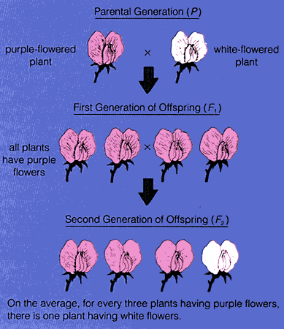
Section 1: The Origin of Genetics
P generation – Purple x White
Parental Generation (True-bred)
F₁ generation – All Purple plants
1st Filial Generation
F₂ generation – 705 Purple plants
& 224 White plants
2nd Filial Generation

Slide 7
Section 1: The Origin of Genetics
Results:
3:1 ratio
For each of the 7
characters Mendel
studied, he found the
same ratio.

Slide 8
Section 2: Mendel’s Theory
Before Mendel’s experiments, many people thought offspring were a blend of the traits of their parents.
Mendel’s results did NOT support the blending hypothesis.
When gametes fuse (fertilization) the offspring has two forms of each trait, one from each parent.

Slide 9
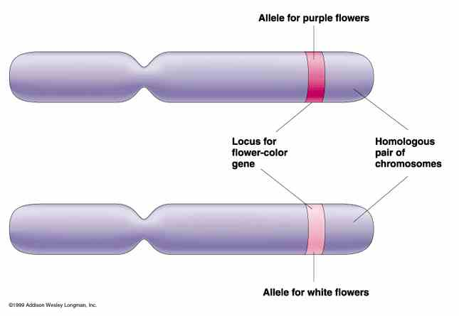
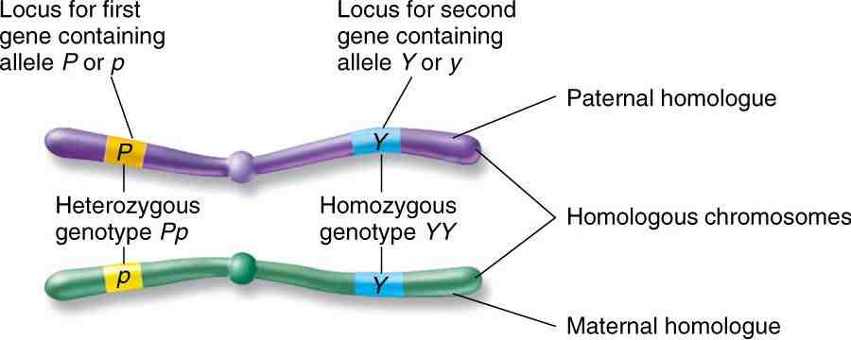
Section 2: Mendel’s Theory
Mendelian Theory of Heredity:
For each inherited trait, an individual has two copies of the gene – one from each parent
There are alternative versions of genes.
Alleles – one of the alternative forms of a gene that governs a characteristic

Slide 10
Section 2: Mendel’s Theory
When two different alleles occur together, one may be completely expressed, while the other may not show up (appearance)
Dominant – expressed form of the character
Recessive – not expressed when dominant form is present

Slide 11
Section 2: Mendel’s Theory
Egg and sperm cells (gametes) only carry one allele for each inherited trait.
Letters are often used to represent alleles.
Dominant alleles are indicated by a capital letter (A).
Recessive alleles are indicated by a lowercase letter (a).

Slide 12
Section 2: Mendel’s Theory
Homozygous – if the two alleles present are the same (AA or aa).
Heterozygous – if the two alleles present are different (Aa).
AA x aa
Aa x Aa
A
A
A
a
a
Aa | Aa
Aa | Aa
All offspring are Aa
A
AA | Aa
Aa | aa
1 – AA
2 – Aa
1 - aa
a
a

Slide 13
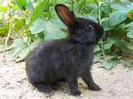
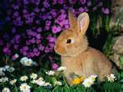
Section 2: Mendel’s Theory
B = black fur & b = brown fur
Genotype – genetic makeup of an organism (BB, Bb, or bb)
Phenotype – physical appearance of an organism (black or brown fur)
B
b
1 –BB
2 – Bb
1 – bb
1:2:1 = genotypic ratio
B
BB | Bb
Bb | bb
b
3 – black fur
1 – brown fur
3:1 = phenotypic ratio

Slide 14
Section 2: Mendel’s Theory
Laws of Heredity:
Law of Segregation – alleles of a gene separate from each other during meiosis
Law of Independent Assortment – alleles of different genes separate independently of one another
Ex: A couple has two children, one with brown hair and blue eyes and one with brown hair and brown eyes (same hair color but different eye color)

Slide 15
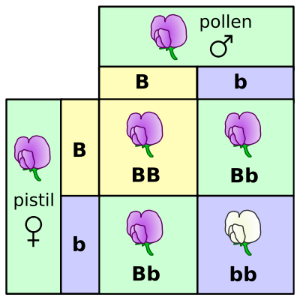
Section 3: Studying Heredity
Punnett square – a diagram that predicts the outcome of a genetic cross

Slide 16
Section 3: Studying Heredity
Probability – the likelihood that an event will occur
Can be expressed as decimals, percentages, or as fractions
Probability =
number of one kind of possible outcome
total number of all possible outcomes

Slide 17
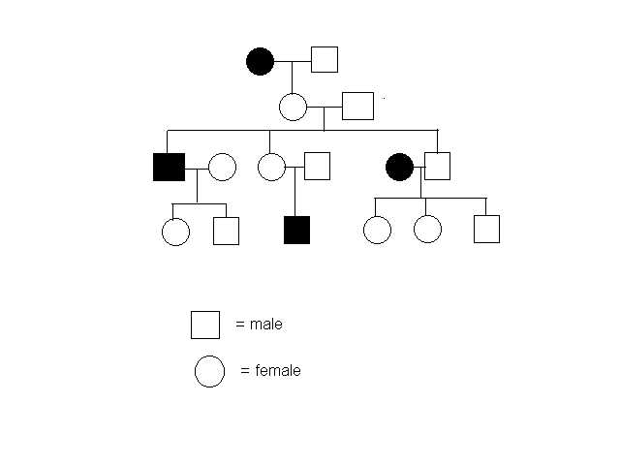
Section 3: Studying Heredity
Pedigree – a family history that shows how a trait is inherited over several generations
Carriers are individuals who are heterozygous for an inherited disorder but do not show symptoms of the disorder.
They can pass the allele for the disorder to their offspring.
Used to find out if someone is a carrier for a genetic disorder

Slide 18
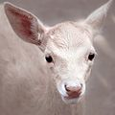
Section 3: Studying Heredity
If a condition is recessive, an individual with the condition can have one, two, or neither parent show the condition.
Ex: Albinism

Slide 19
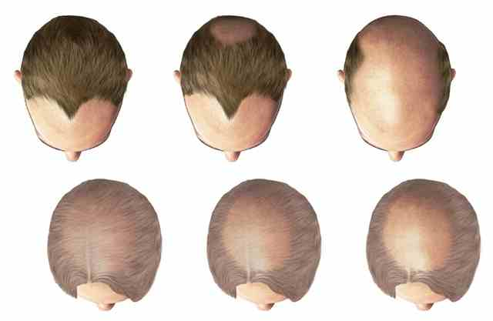
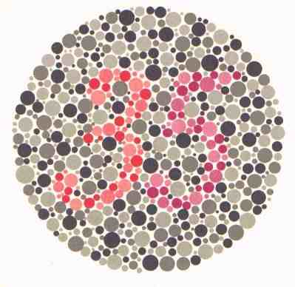
Section 3: Studying Heredity
Autosomal-linked genes – genes found on the autosomes
Sex-linked gene – alleles that are located only on the X or Y chromosome
Most are carried on the X chromosome & are recessive
Color blindness, male-pattern baldness, hemophilia
Shows up more often in males

Slide 20
Section 4: Complex Patterns of Heredity
Polygenic inheritance – when several genes influence a trait
Human eye color, height, weight, and hair and skin color
All of these traits have degrees of intermediate conditions between one extreme and the other

Slide 21
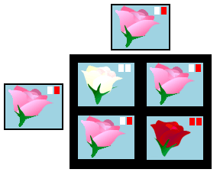
Section 4: Complex Patterns of Heredity
Incomplete dominance – a trait that is an intermediate between the phenotype of both parents because the dominant allele is unable to express fully (completely masking the recessive)

Slide 22
Section 4: Complex Patterns of Heredity
Multiple Alleles – genes with three or more alleles
(Ex: human blood type; I^{A}, I^{B}, i)
Type A = I^{A}I^{A} or I^{A}i
Type B = I^{B}I^{B} or I^{B}i
Type AB = I^{A}I^{B}
Type O = ii
Codominance – two dominant alleles are expressed at the same time

Slide 23
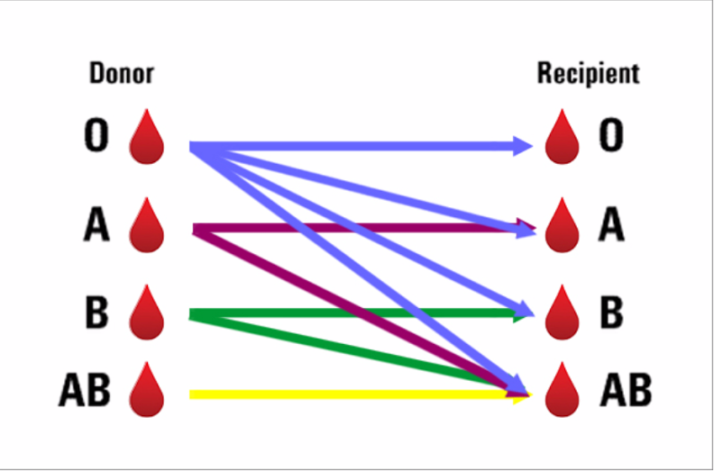

Slide 24
Section 4: Complex Patterns of Heredity
Genetic Disorders:
Sickle Cell Anemia – recessive genetic disorder
- caused by a mutated allele that produces a defective hemoglobin
-causes red blood cells to become sickle-shape, they rupture easily, get stuck in blood vessels, & can cut off blood supply

Slide 25
Cystic Fibrosis –hereditary recessive disorder among Caucasians
- airways in the lungs are clogged with thick mucus; liver ducts and pancreas become blocked
- No known cure; average life expectancy is between 42-50 years. 80% of CF deaths are due to lung issues.

Slide 26
Hemophilia – recessive genetic disorder that prevents blood from clotting.
Typically causes internal bleeding, not necessarily excessive bleeding from small cuts/scrapes
Is a sex-linked disease. It is a mutation on the X sex chromosome. Females are carriers.

Slide 27
Huntington’s Disease – caused by a dominant allele found on a chromosome
-causes loss of muscle control, uncontrollable muscle spasms, severe mental illness, and eventually death

Slide 28
Muscular Dystrophy- Genetic condition in which the muscles

Slide 29
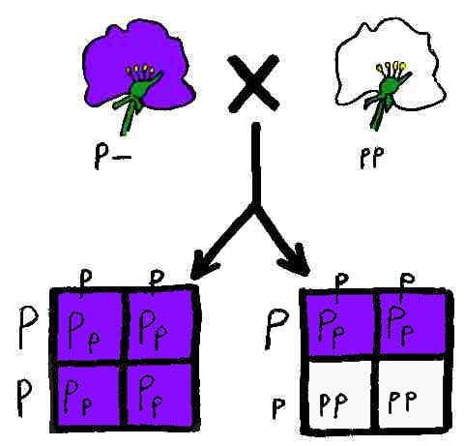
Section 3: Studying Heredity
Test cross – an individual whose phenotype is dominant but the genotype is unknown, is crossed with a homozygous recessive individual

Slide 30
Brown hair is a dominant hair color allele and red hair is recessive. A brown-haired man whose father had brown hair and whose mother was a carrier for red hair, marries a red-haired woman. They have two sons, one with red hair and one with brown hair. Draw a pedigree showing this family. Shade in all carriers half way.

Slide 31
Achondroplasia is a recessive trait. A woman who is a carrier marries a man who is also a carrier. They have four children, all girls. The first girl has achondroplasia. The middle girls are carriers. The couple’s youngest child does not inherit the trait. The first girl who has achondroplasia marries a man who does not have the trait. The two have two children, a boy and a girl. Do either of the children have achondroplasia?

Slide 32
In chimpanzees, right hand dominance (R) is dominant. Determine the outcome of a genetic cross between a homozygous dominant right-handed chimp and a homozygous recessive chimp. Draw a punnett square.
List possible genotypes
List possible phenotypes

Slide 33
In frogs, the appearance of spots (S) across the back is domiant. Determine the outcome of a genetic cross between a heterozygous frog and a frog with NO spots. Draw a punnett square.
List possible genotypes
List possible phenotypes

Slide 34
In humans, attached earlobes (e) are recessive to unattached earlobes. Determine the outcome of a genetic cross between a man and woman who are both heterozygous for unattached earlobes. Draw a punnett square
List possible genotypes
List possible phenotypes

Slide 35
In an octopus, tan (T) coloring is dominant over purple coloring. Determine the outcome of a genetic cross between a male octopus that is purple and a homozygous dominant female. Draw a punnett square.
List the possible genotypes
List the possible phenotypes

Slide 36
In ladybugs, red coloring (R) is dominant over orange coloring. Determine the outcome of a genetic cross between two orange ladybugs. Draw a punnett square.
List the possible genotypes
List the possible phenotypes

Slide 37
Albinism is passed down as a recessive trait. Two normally pigmented parents, Leigh and Ron, have 4 children. Their son Chad and daughter Alexis have normal pigmentation. Their third child, Aubrey has albinism. Their fourth child Jason has normal pigmentation. Aubrey marries a normally pigmented man, Ben, and they have two children. The first child, Violet, has normal pigmentation. Their second child, Jack, has albinism. Their son Chad marries a normally pigmented woman, Angela. The two have three children. The first, Sophia, has albinism, while the other two, David and Joseph, have normal pigmentation. Figure out all carriers!

