Slide 1
Chapter 11
Chromosomes and Cell Reproduction

Slide 2
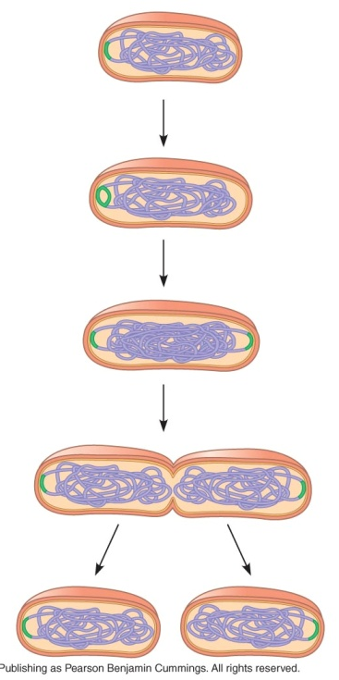
Section 1: Chromosomes
Reminder: Prokaryotic cells (bacteria) reproduce by BINARY FISSION.
Parent cells and daughter cells are CLONES (or genetically identical)

Slide 3
Section 1: Chromosomes
Eukaryotic cells (animal, plant, fungus, protist cells) use MITOSIS.
MITOSIS-process by which cell reproduce.
Egg and sperm cells must be formed by a different process.
GAMETE-sex cells; egg and sperm
MEIOSIS-cell division process used to form gametes.
More on Mitosis and Meiosis later on. ☺

Slide 4
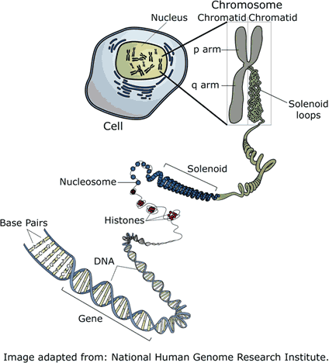
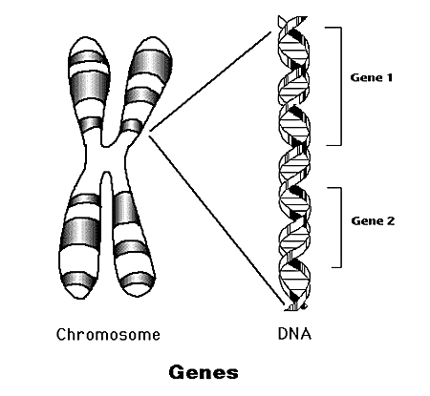
Section 1: Chromosomes
GENE – segment of DNA that codes for a protein or RNA molecule

Slide 5
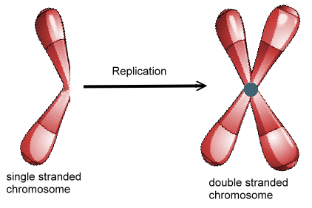
Section 1: Chromosomes
Chromosome – tightly twisted DNA and proteins; looks like an “X”
Chromatids – 2 exact copies of DNA that make up each chromosome; ½ of each “X”
Centromere – holds the 2 chromatids together
Centromere

Slide 6
Section 1: Chromosomes -how chromosome number and structure affect development
Somatic cell – “body cells;” any cell in the body other than sperm or egg cells (gametes)
Human somatic cells contain 2 sets of chromosomes = 46.
Each pair of chromosomes in a somatic cell come from one of the 2 parents.
The chromosomes differ in shape & size.

Slide 7
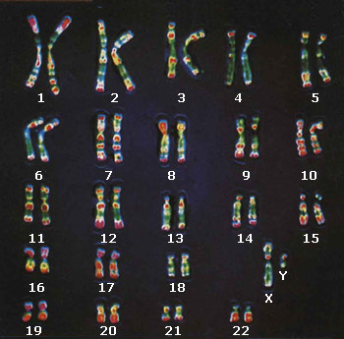
Section 1: Chromosomes -how chromosome number and structure affect development
Homologous chromosomes – chromosomes that are similar in size, shape, and genetic content.
This picture shows the 2 copies of each chromosome; one from mom and one from dad.

Slide 8
Section 1: Chromosomes -how chromosome number and structure affect development
Diploid cell (somatic) – cells that contain 2 sets of chromosomes (2n)
Humans: 2n = 46
Haploid cell (gametes) – cells that only contain 1 set of chromosomes (n)
Human egg and sperm cells are (n) = 23
Zygote – a fertilized egg cell, the 1st cell of a new individual (diploid)

Slide 9
Section 1: Chromosomes -Sex Chromosomes
Sex chromosomes – chromosomes that determine the gender (sex) of an organism
We have 1 pair of sex chromosomes (X and Y)
Autosomes – chromosomes that are NOT involved in determining gender; all the other chromosomes
We have 22 pairs of autosomes
22 autosome pairs + 1 sex chromosome pair =
23 pairs of chromosomes

Slide 10
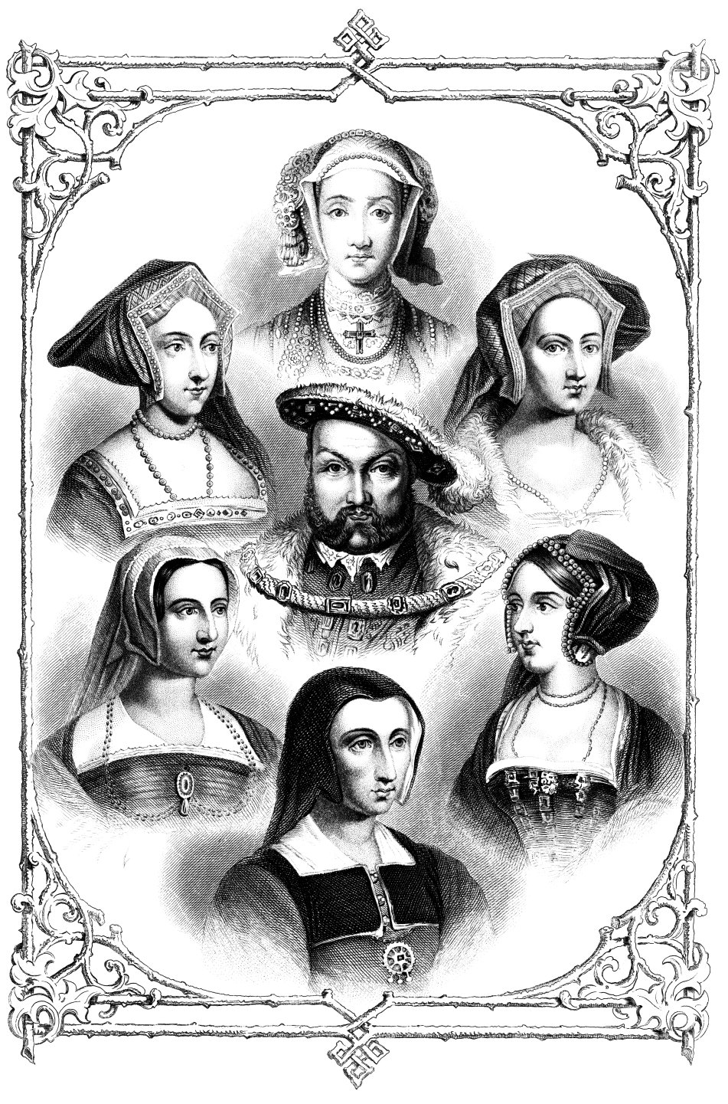
Section 1: Chromosomes -Sex Chromosomes
Female eggs contribute only an X sex chromosome.
Male sperm may contribute either an X or Y sex chromosome.
Male babies = XY Female babies = XX
The presence of a Y sex chromosome declares “maleness.”
Who determines if the baby will be a girl or a boy?

Slide 11
Section 1: Chromosomes -Change in chromosome number
Trisomy – term for humans with more than 2 copies of any chromosome, the person will not develop as usual
Trisomy 21 – having an extra copy of chromosome 21
Known as Down Syndrome – individual has 47 chromosomes)

Slide 12
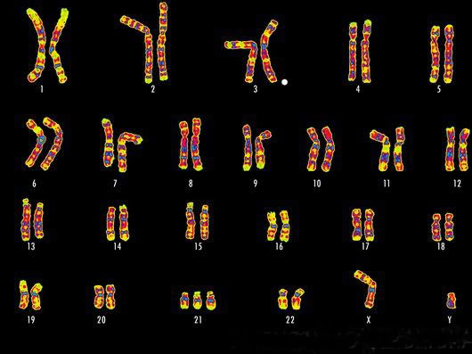
Can you find the Trisomy in this karyotype?

Slide 13
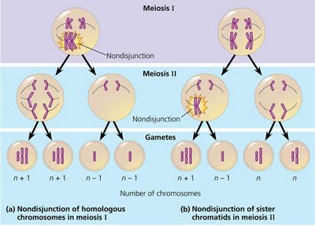
Section 1: Chromosomes -Change in chromosome number
Nondisjunction – One or more chromosomes fail to separate properly. One gamete gets one too many chromosomes & another gamete gets one less.

Slide 14
Section 1: Chromosomes -Change in chromosome number
Mutation – changes in structure of an organism’s chromosome
4 types of mutations:
1. Deletion – piece of a chromosome breaks off completely
2. Duplication – extra copies of the same gene

Slide 15
Section 1: Chromosomes -Change in chromosome number
4 types of mutations (continued)
3. Inversion – chromosome piece reattaches to original chromosome in reverse
4. Translocation – when a piece of a gene reattaches to a nonhomologous chromosome

Slide 16
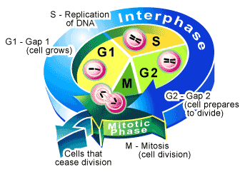
Section 2: Cell cycle -Life in a eukaryotic cell
The Cell Cycle – repeating sequence of cellular growth & division during the life of an organism (5 phases)
Cell Cycle INCLUDES Mitosis.
Interphase includes the first 3 stages: G1, S, and G2
Interphase takes up 90% of a cell’s life.

Slide 17
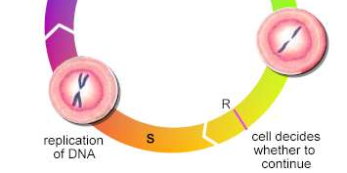
Section 2: Cell cycle -Life in a eukaryotic cell
Phases of the Cell Cycle:
G1 phase – cell grows rapidly & carries out its routine functions (its job)
“first growth”
Some cells never leave this phase because they are not dividing (ex. Nerve/brain cells, muscle cells)
S phase – cell’s DNA is synthesized or copied
At the end of this phase, each chromosome consists of 2 chromatids attached at the centromere

Slide 18
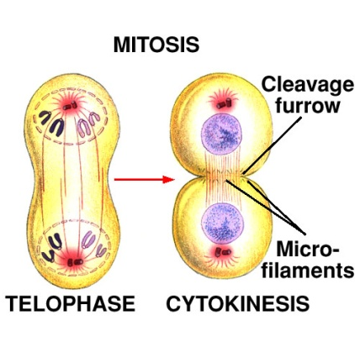
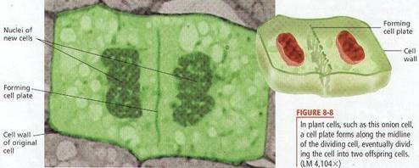
Section 2: Cell cycle -Life in a eukaryotic cell
G2 phase – nucleus prepares to divide
“second growth”
M phase – Mitosis; nucleus divides into 2 nuclei
Consists of 4 stages (prophase, metaphase, anaphase, telophase)
Cytokinesis – cytoplasm divides & the cell splits
Animal Cells – belt of proteins fibers pinch the cell in half
Plant Cells – have a cell wall and create a cell plate in the middle of the cell

Slide 19
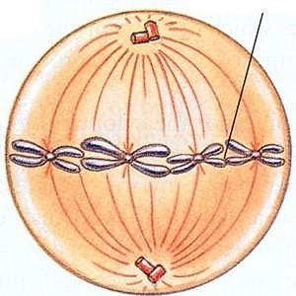
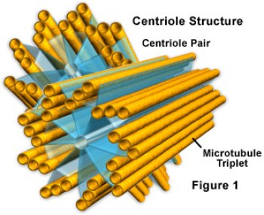
Section 3: Mitosis & Cytokinesis -chromatid separation
Spindles – cell structures made up of both centrioles and microtubule fibers
- moves chromosomes during cell division
Forming the Spindle:
Centrosomes produce hollow fibers of protein at the cell’s poles

Slide 20
Section 3: Mitosis & Cytokinesis -chromatid separation
Mitosis:
Prophase – chromosomes coil up, and nuclear membrane dissolves; spindles form
*key word: PREPARE

Slide 21
Section 3: Mitosis & Cytokinesis -chromatid separation
Metaphase – chromosomes move to the center of the cell; spindle fibers attach to centromeres
*key word: MIDDLE

Slide 22
Section 3: Mitosis & Cytokinesis -chromatid separation
Anaphase – centromeres divide; chromosomes move toward opposite ends
*key word: APART

Slide 23
Section 3: Mitosis & Cytokinesis -chromatid separation
Telophase – Nuclear membrane forms at each end; chromosomes uncoil; spindle dissolves; cytokinesis begins
*key word: TWO

Slide 24
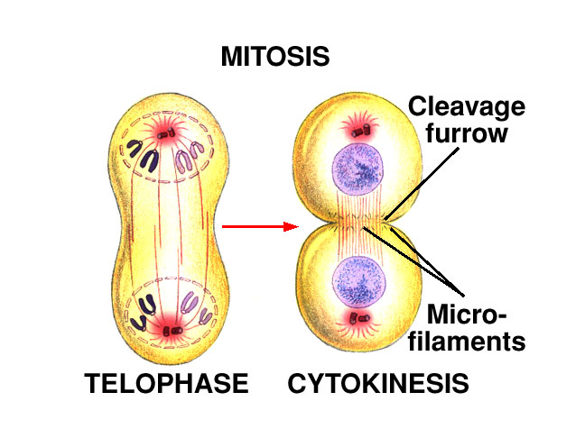
Section 3: Mitosis & Cytokinesis -chromatid separation
Cytokinesis:
cytoplasm is divided in half; cell membrane grows to enclose each cell
Animal Cells – (lack a cell wall) cell is pinched in half by a belt of protein threads

Slide 25
Section 3: Mitosis & Cytokinesis -chromatid separation
Cytokinesis in Plant cells:
Contains a rigid cell wall
Vesicles formed by the Golgi apparatus fuse at the midline of the dividing cell & form a cell plate
New cell wall then forms on both sides of the cell plate

Slide 26
Cancer -Control of the cell cycle
The cell cycle is controlled by proteins known as check points
G1 checkpoint – decides whether the cell divides or not (end of G1 phase)
G2 checkpoint – DNA replication is checked by repair enzymes
Mitosis checkpoint – triggers the exit from mitosis; signals G1 phase

Slide 27
Cancer -Control of the cell cycle
What happens if control is lost?
Cancer – the uncontrolled growth of cells
Cancer cells do not respond normally to the body’s control mechanism
Some mutations can cause the speeding up of the cell cycle
Some mutations can prevent cell cycle from slowing down or stopping

